Slide 1

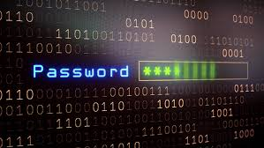
Password Generator
CODERS:
Yaritza Hernandez
Jacob Kahn
A tool designed to generate random passwords based on desired length to allow a user to gain access to a device, application, or website.
https://github.com/ksu-is/PasswordGenerator.com

