Slide 1
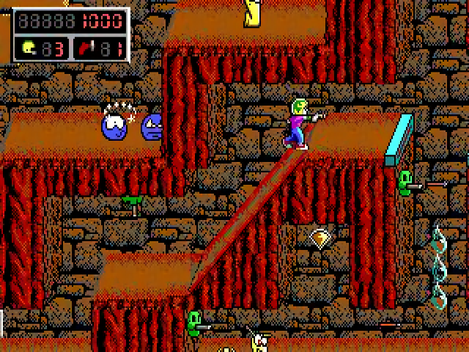
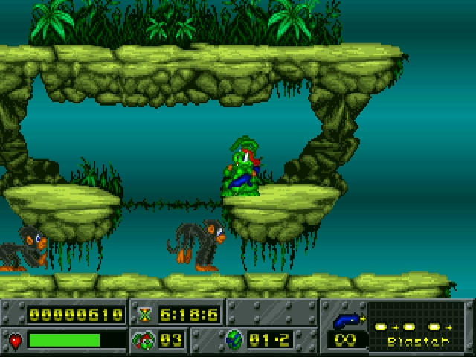
Daniel Smith Platformer Game - A video game created with Pygame where the player navigates levels from a 2D perspective and fights through enemies to reach the end.

