Slide 1

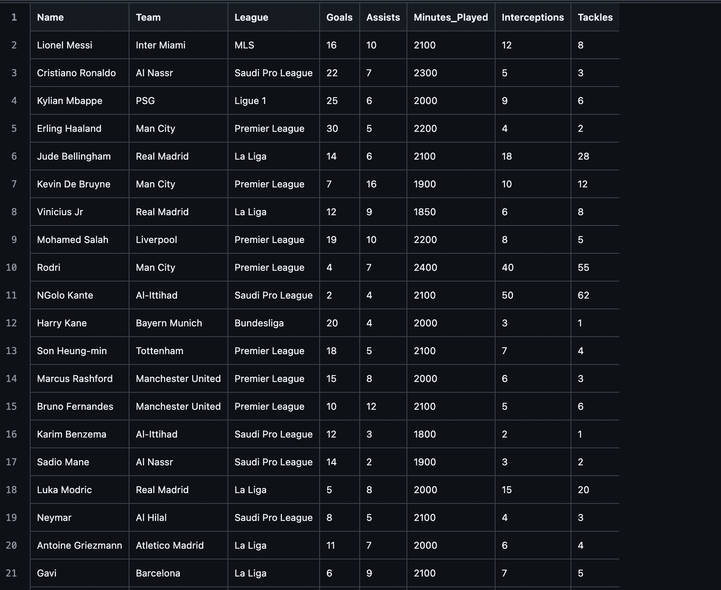
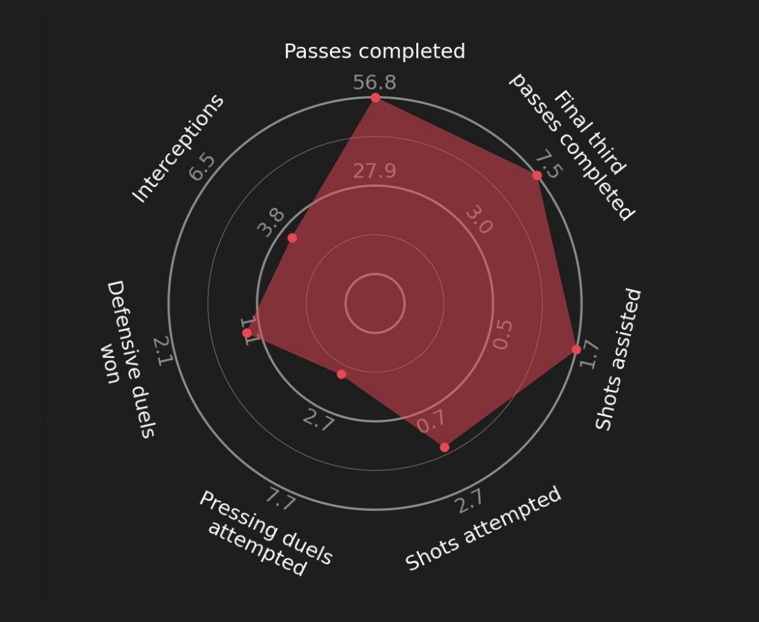
Pro-Soccer-Statistics
By Edwin Veliz & Danny Nguyen
What will the program do?
Pro-Soccer-Statistics will centralize professional soccer stats for players, teams, and leagues.
It will allow users/fans to compare performance across seasons and regions
The program goes beyond basic stats by tracking trends and progress over time.
Track. Compare. Analyze. All in One.

