Slide 1
Photo Exif Application
Faster, Easier Photo Metadata Management
By Nguyet Le
Professor Thomas Dominic, KSU
Jul 20, 2023

Slide 2
Photo Exif Application
Context
Ideas and Plans
Process
Result
Reference
Q & A

Slide 3

Context
I took this photo in Kennesaw. Do you know where is this exact location?

Slide 4
Photo data questions?
How to know a photo location?
How to know when was it taken?
Is it possible to know a photo data?
Please raise your questions regarding a photo data you want to know
Context

Slide 5
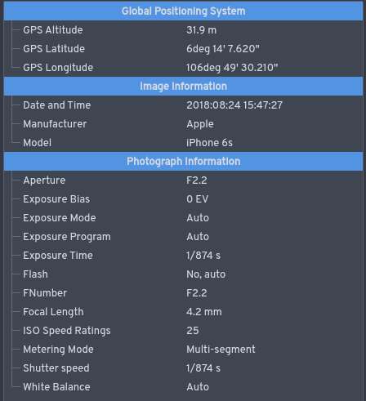
Create a software to capture a photo exif
(date, time, file name, location…)
Ideas
Extract data to Excel or CSV file for later development

Slide 6

Accessible Photo Edit software (Lightroom, Pillow, Canva…)
Photo storage location (computer or outsource)
Available repositories
Sheet design
Copyrights and testing
Plans

Slide 7
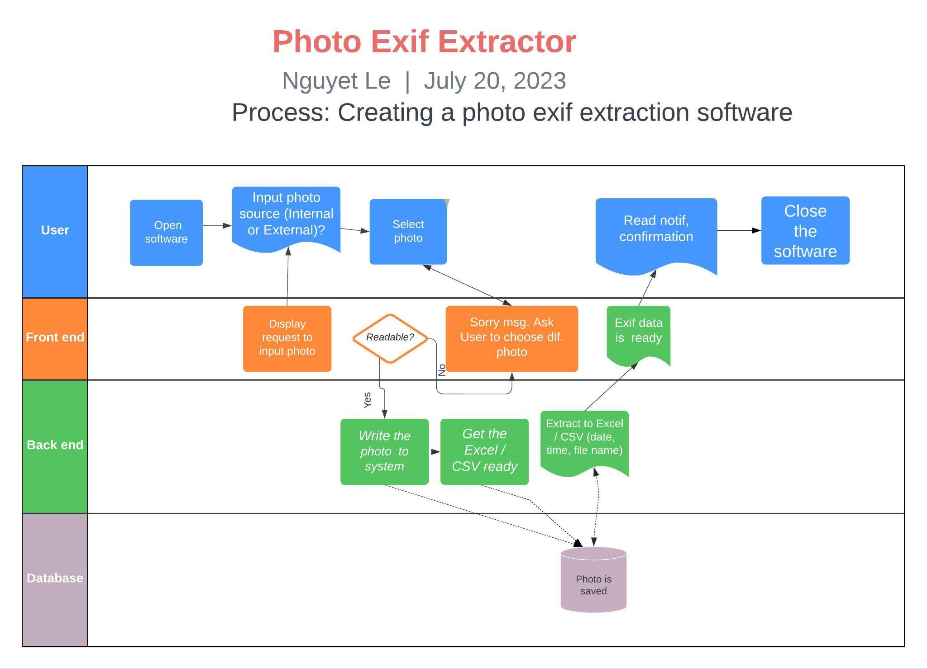
Process

Slide 8
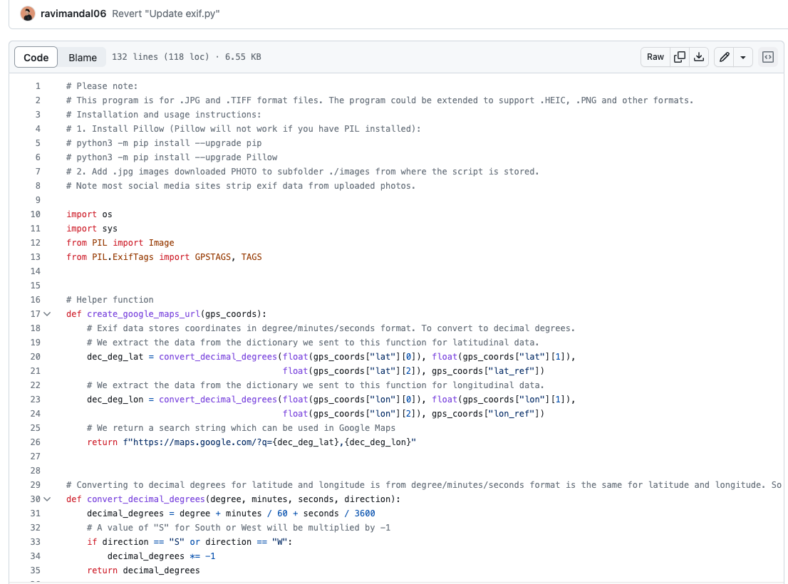
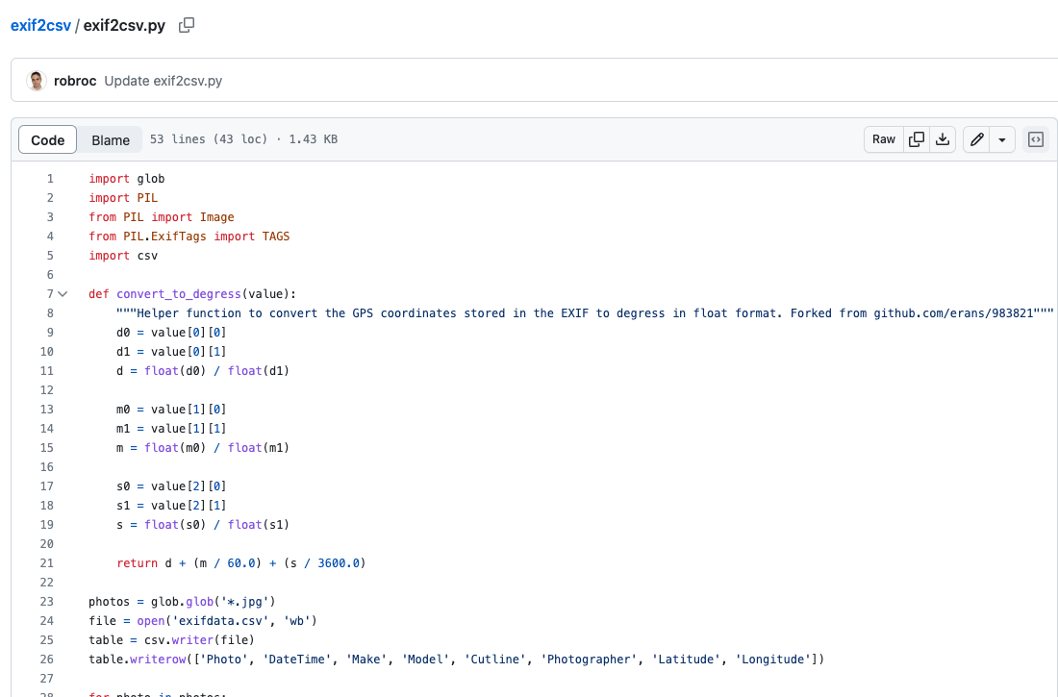
Final Repository
-2/5 selected
Dated back from 2013 and 2022
Obstacles
Process
-Complicated
-Outdated

Slide 9
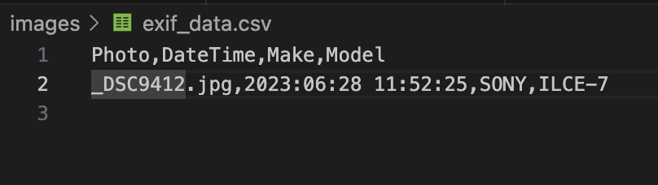
Result
Combined 2 repositories.
Unable to extract the location if GPS was not turned on.

Slide 10
References
https://github.com/ravimandal06/Python-Exif-script
https://github.com/robroc/exif2csv

Slide 11
Q & A
Can I reproduce this repository?
Yes, for education purpose only.
Can it read photo exif downloaded from internet?
Yes, but I haven't checked the development yet.

