Slide 1
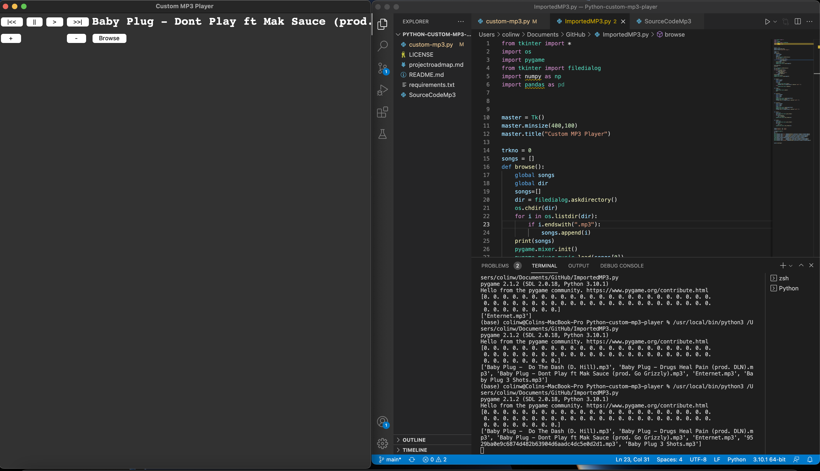
CUSTOM MP3 PLAYER
Purpose
Coders
Allow users to listen to their mp3 and wav files continuously without having to break in between. Requires no manual effort from user other than placing sound files in folder.
An example of the MP3 Player Interface
An example of the songs in the folder, visible in the Terminal
Colin Williams

