Slide 1
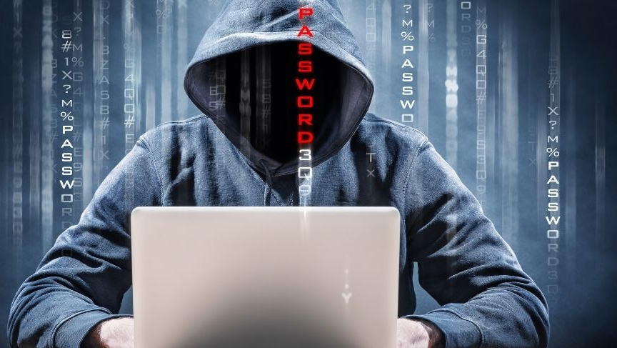
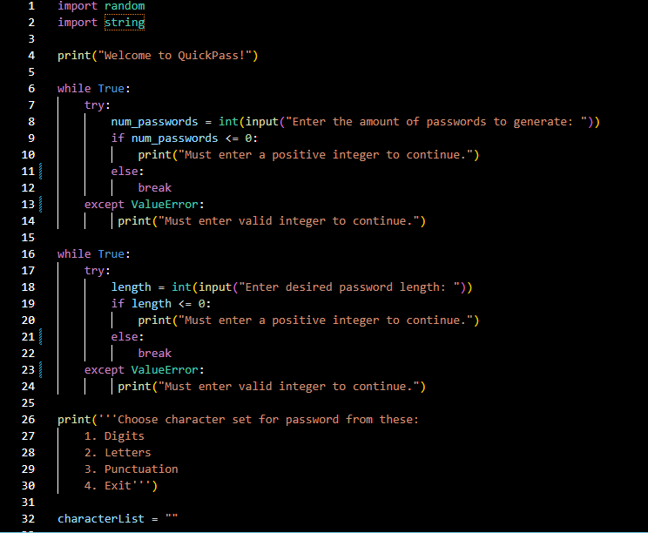
QuickPass
Keep those hackers out of your private information by using this code to create strong passwords with a mix of numbers, letters, and special characters.
Coded by: Angela Ajuebor
https://github.com/ksu-is/QuickPass-RandomPasswordGenerator

