Slide 1
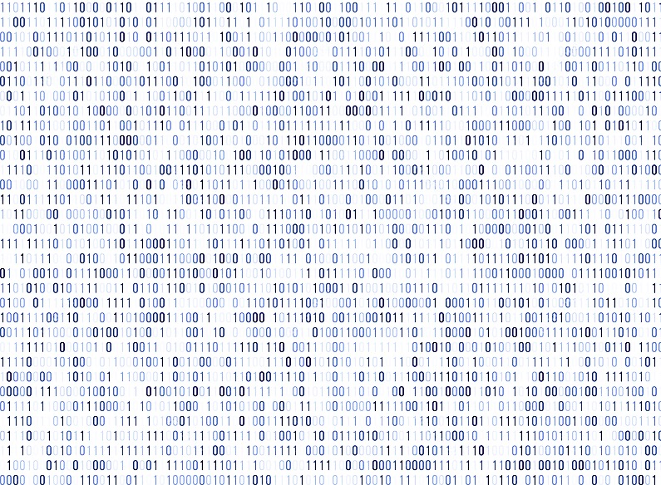

RHA INVENTORY SOFTWARE NEJRA LILIC & JONNATHAN PALACIOS

