Slide 1

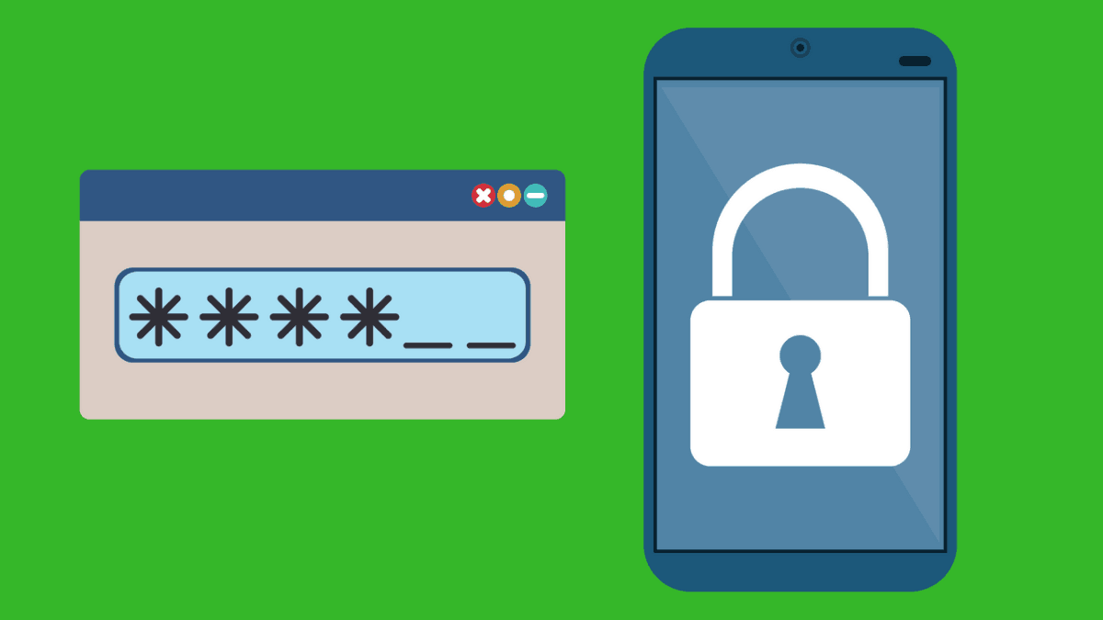
Random Password Generator – Lukas Aaro-Hansen
Do you ever have difficulty creating and memorizing complex passwords? Look no further! I have created a program that constructs a password of a custom length with random letters, numbers, and special characters.
This Photo by Unknown Author is licensed under CC BY-NC

