Slide 1


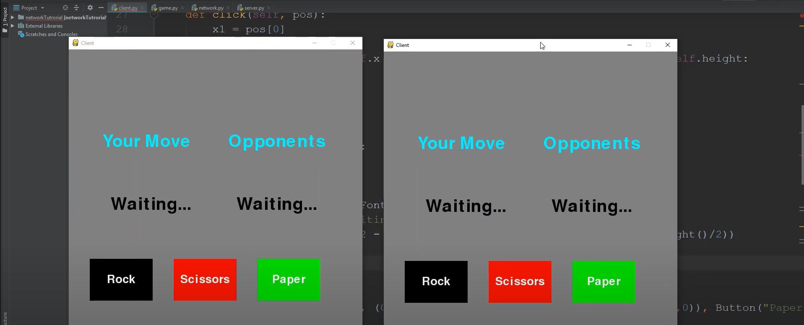
Rock-Paper-Scissors
By: Carson Barnett
Play Rock-Paper-Scissors with a friend through your code!

