Slide 1
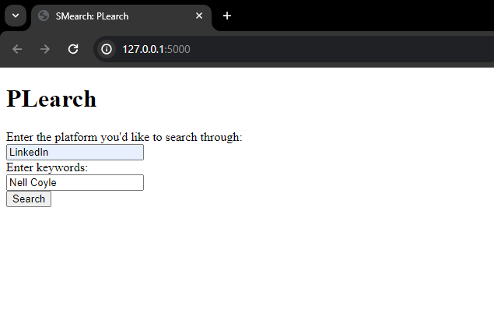
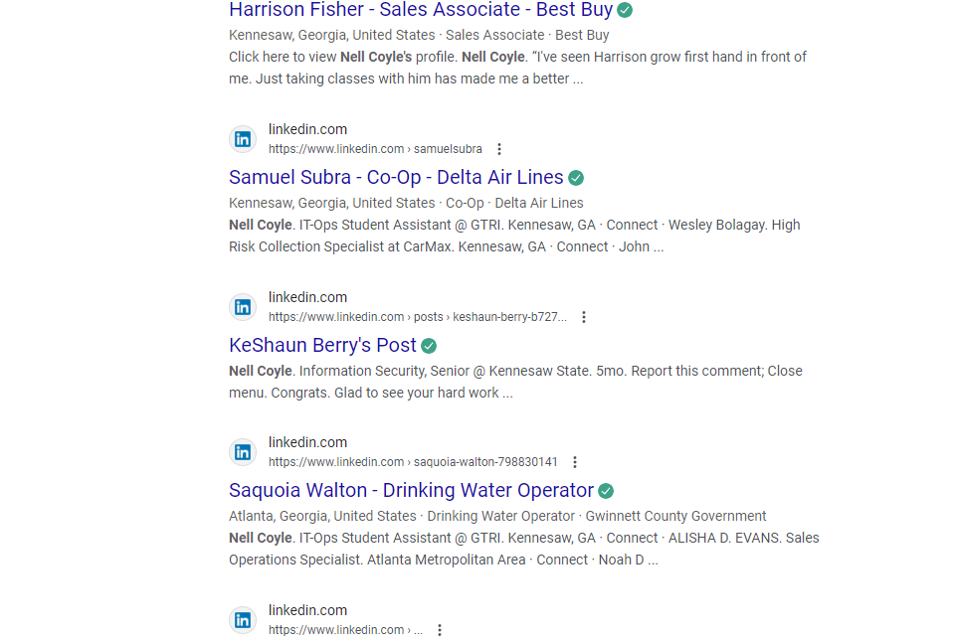


PLearch
Takes in the user's inputs & uses the user's default web browser to auto search the keywords provided on the platform they type in.
A SMearch App by Nell Coyle

