Slide 1
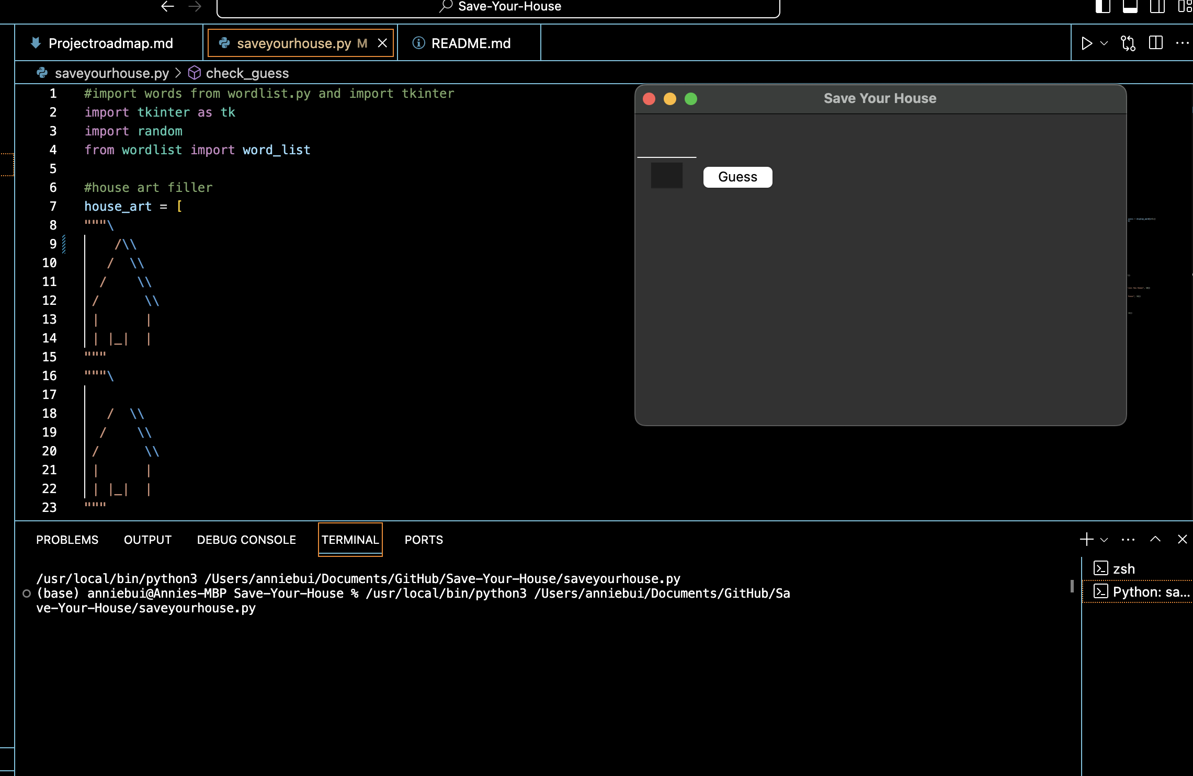

Save your house
A twist to the classic hangman game
Play on our python Gui program to uncover hidden words to save your house from deconstruction!
DIDN’T YOU HEAR? SAVE YOUR HOUSE IS THE NEW WORDLE!
Annie Bui, Lauren Seliski

