Slide 1
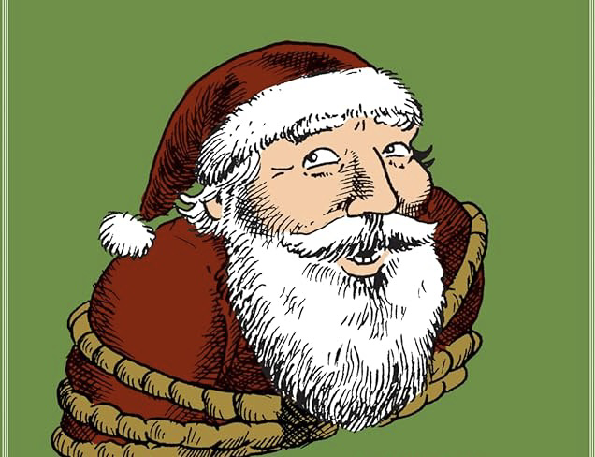
Saving Santa – Text-Based Game
By: Alaysiah Hernton

