Slide 1
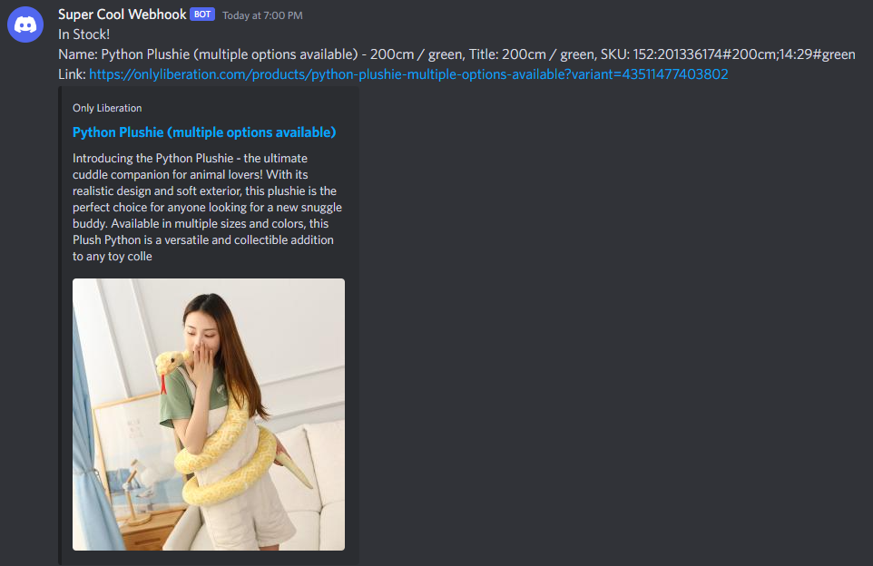
Shopify Notifier Bot
Preston Revennaugh
Tracks when stock status of items changes on Shopify sites and sends webhook notifications.
https://github.com/ksu-is/Shopify_Notifier_Bot

