Slide 1
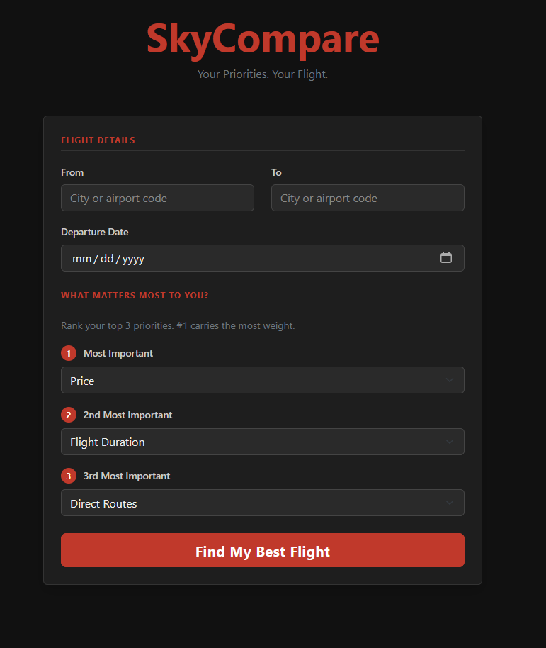
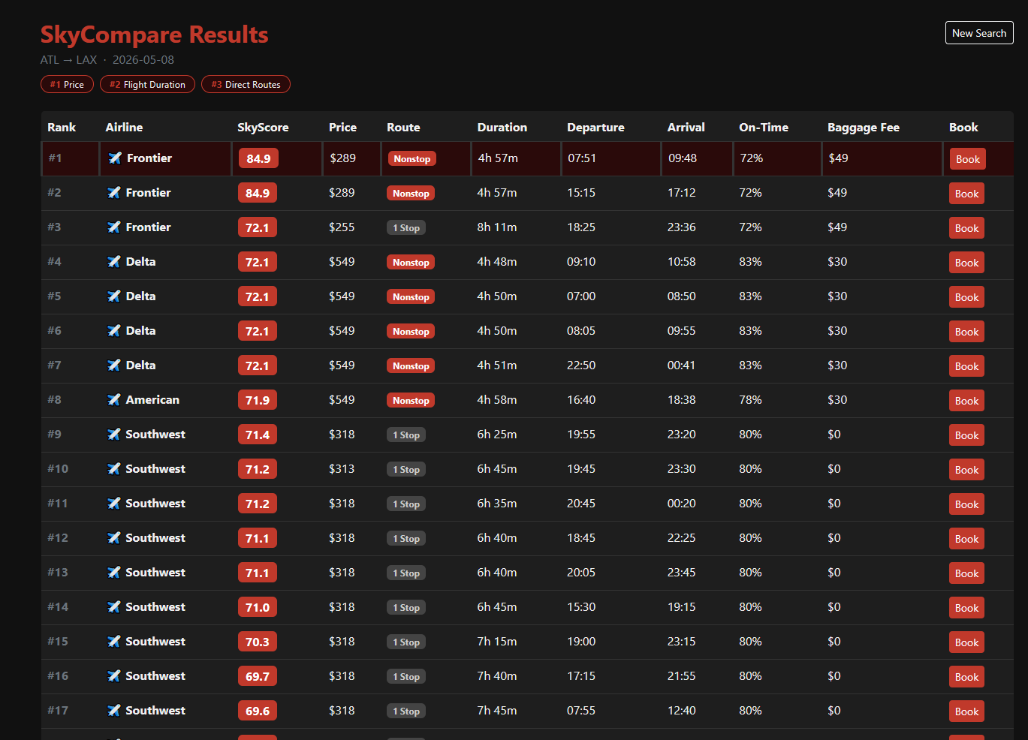
SkyCompare
SEARCH INTERFACE
RANKED RESULTS
Your Priorities. Your Flight.
Jaylen Early
IS Project · Spring 2026
github.com/ksu-is/SkyCompare
▸ Live prices from Google Flights via SerpAPI
▸ AviationStack for real departure & arrival times
▸ Airport autocomplete — 80+ US airports
▸ 3-priority ranking system powers the SkyScore
▸ Direct booking links pre-filled with route & date
▸ Red & black dark UI built on Bootstrap 5
SkyCompare helps travelers cut through the noise — not just finding the cheapest flight, but the right flight based on what matters most to them.

