Slide 1
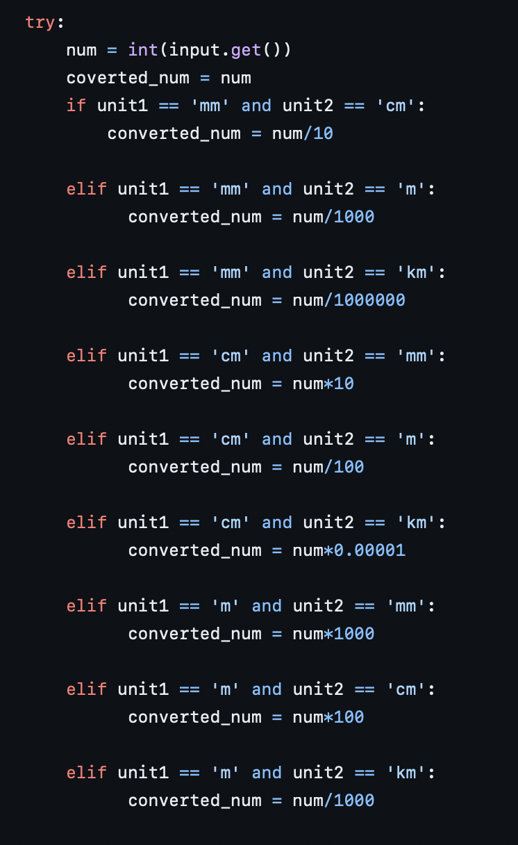
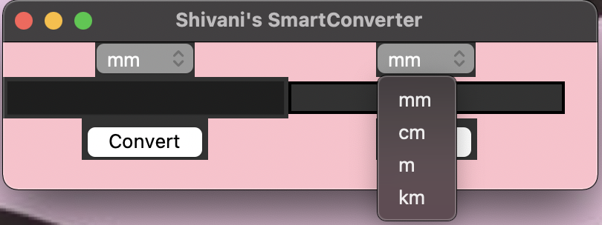
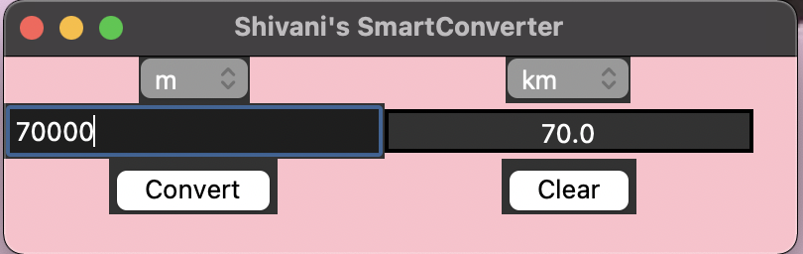
Shivani’s SmartConverter
I created a SmartConverter allows users to easily convert between (the most confusing) units of measurement; kilometers, millimeters, meters, and centimeters.
I used TKinter and a calculator GUI to take user input, [what value needs to be converted and the units of measurement for said input value}, and apply a conversion formula to convert the input value to the desired output unit.

