Slide 1
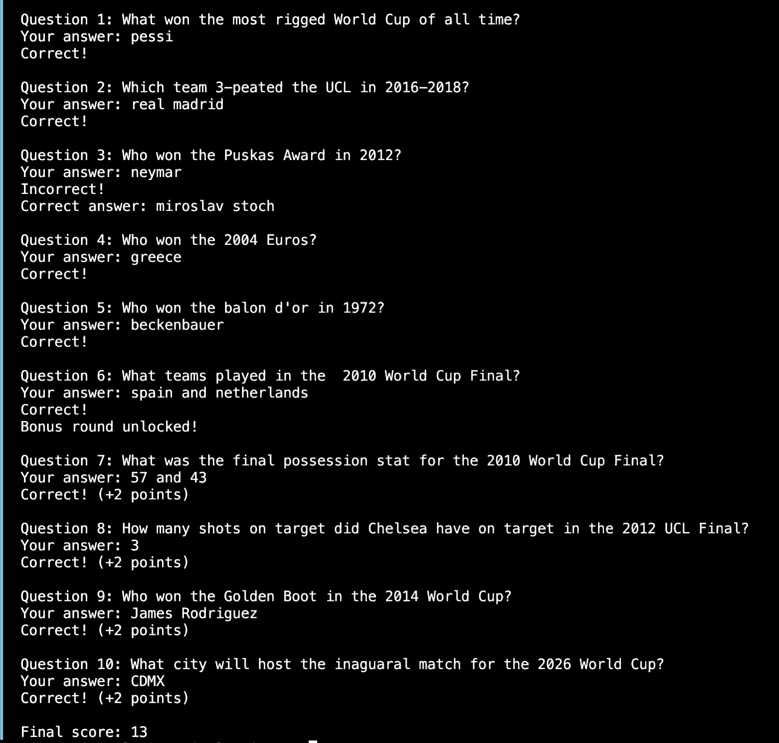
Ball Knowledge By Giovanni Zavala This game/quiz is meant to test your knowledge of game stats, tournament stats, individual awards, etc.
Guess the matchup of certain games
Test your ball knowledge
Get randomized questions
Points multiplier

