Slide 1

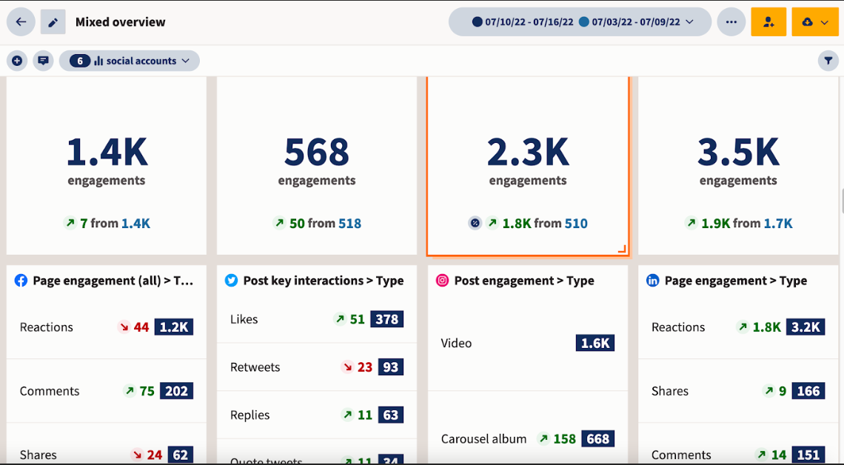
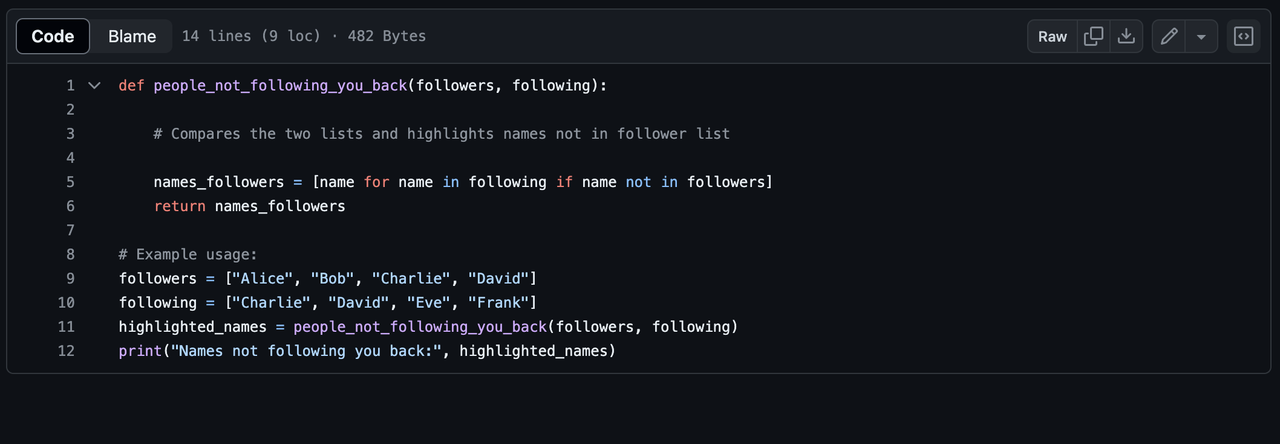
Social Media Tracker
By: Miguel Cuervo
Introducing a streamlined program designed to effortlessly monitor your social media following, enhancing your online engagement strategy. This tool is crucial as it provides valuable insights into follower trends, enabling you to tailor your content for maximum impact and grow your digital presence more effectively.
Result
Progress…
GitHub URL: https://github.com/ksu-is/Social-Media-Tracker

