Slide 1
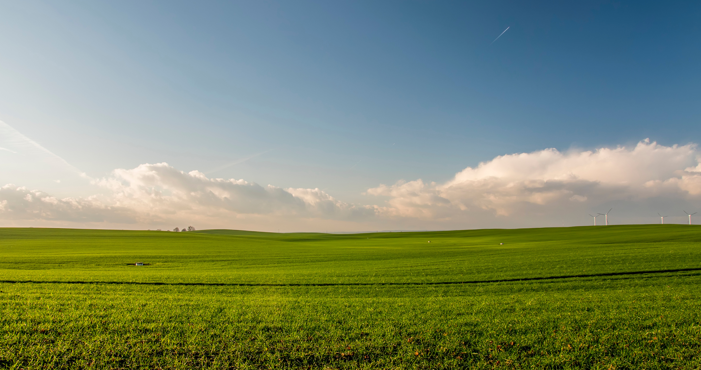





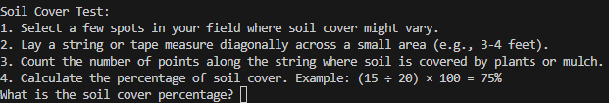
CHECK THE APP OUT ON GITHUB :
HTTPS://GITHUB.COM/KSU-IS/SOIL-HEALTH-CHECKER/TREE/MAIN
SOILHEALTH
HEALTHY SOIL, STRONGER FARMS: SIMPLE TESTS, SMARTER SOLUTIONS.
APPLICATION PURPOSE:
Empower Local Farmers: The app provides farmers with simple, accessible methods to assess the health of their soil using basic tests.
Comprehensive Soil Health Evaluation: It enables farmers to evaluate key soil health indicators, such as compaction, organic matter, organism habitat, and aggregate stability.
Action-Oriented Results: Based on the results, the app identifies potential resource concerns and offers actionable insights to address them.
Connecting Farmers to NRCS: If concerns are detected, the app directs farmers to their local NRCS office for expert advice and assistance.
4 Test Batteries!
Quick Result Responses
Simple with Tests-Clear Directions!
presented by:
Gnerdworx
Team Member: Robert Halsell

