Slide 1
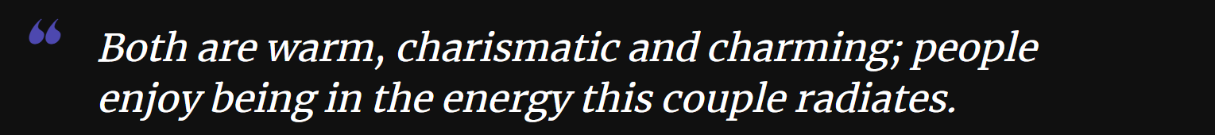
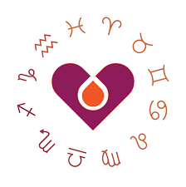
StarStruck; The Zodiac Sign Compatibility App
The All-in-one Zodiac Sign Guesser and MatchMaker!
A Python program that guesses your zodiac sign and chooses which one is the most compatible with you! + comes with a free synopsis!
Coder: Nicolas Robinson
Github Repository: StarStruck
https://www.youtube.com/watch?v=rw6KedFAcy8

Slide 2
Inspiration
My inspiration for this project was that I love my zodiac sign. This made me interested in the other zodiac signs and what made them “them”. Throughout the rabbit hole I went through, I realized that more than just zodiac signs, I like astrology and that whole field. I downloaded apps on my phone (timepassages, Co-star, Nebula, etc…) that dealt with astrology, and I loved all of them.
I realized that there were no zodiac guessing or matchmaking apps, so I figured why not Try and make one myself

Slide 3

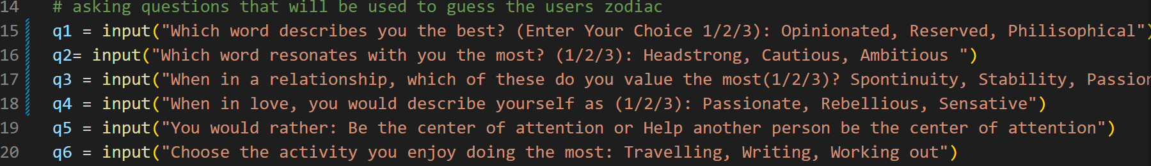
Initial Ideas
Initially the plan was to create a software that not only guesses the zodiac of the user, but also guesses the most compatible match for the user
Software that asks 5-12 questions to the user, and using that comes up with a set of zodiac signs that match

Slide 4
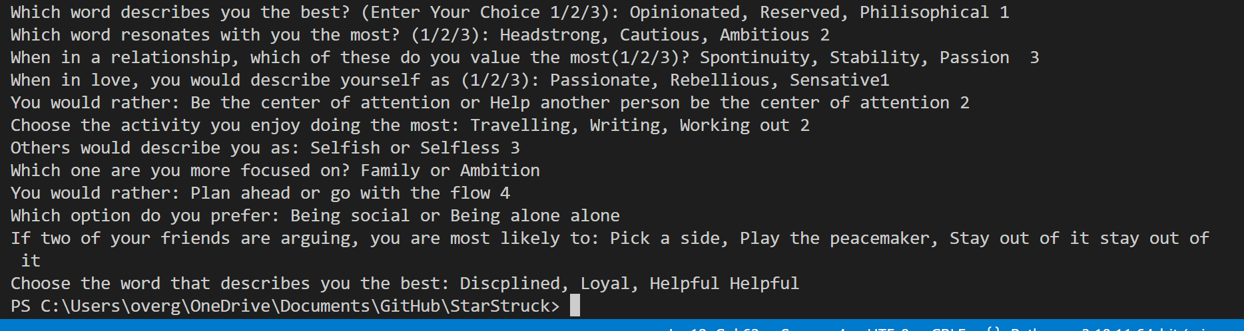
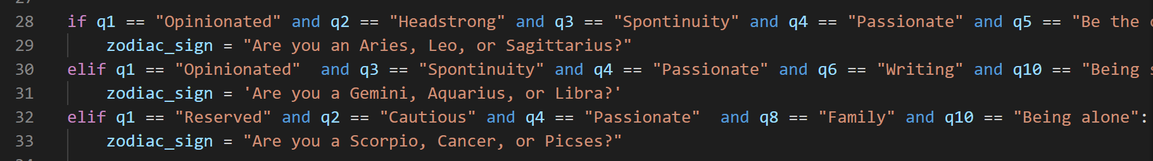
RoadBlocks
I faced a couple roadblocks with my initial code
I couldn’t get my functions to work
The Output code would keep going and never go to the If/else statements

Slide 5

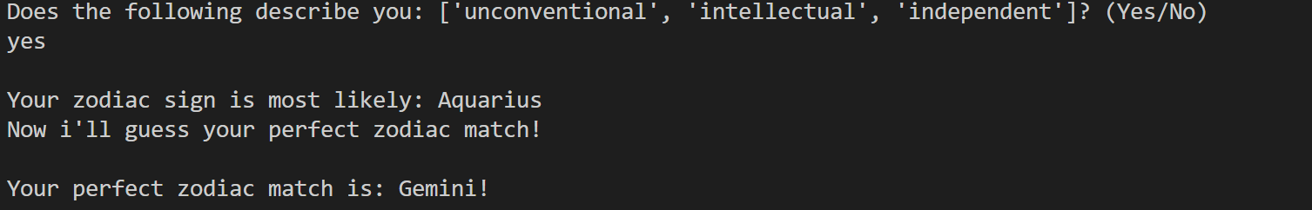
Code Editing
After Realizing that my code was stuck, I decided to scrap it and try to attack it from a different angle
Instead of going through each question 1 at a time to figure out the zodiac, I turned into a Yes or No question for each zodiac

