Slide 1
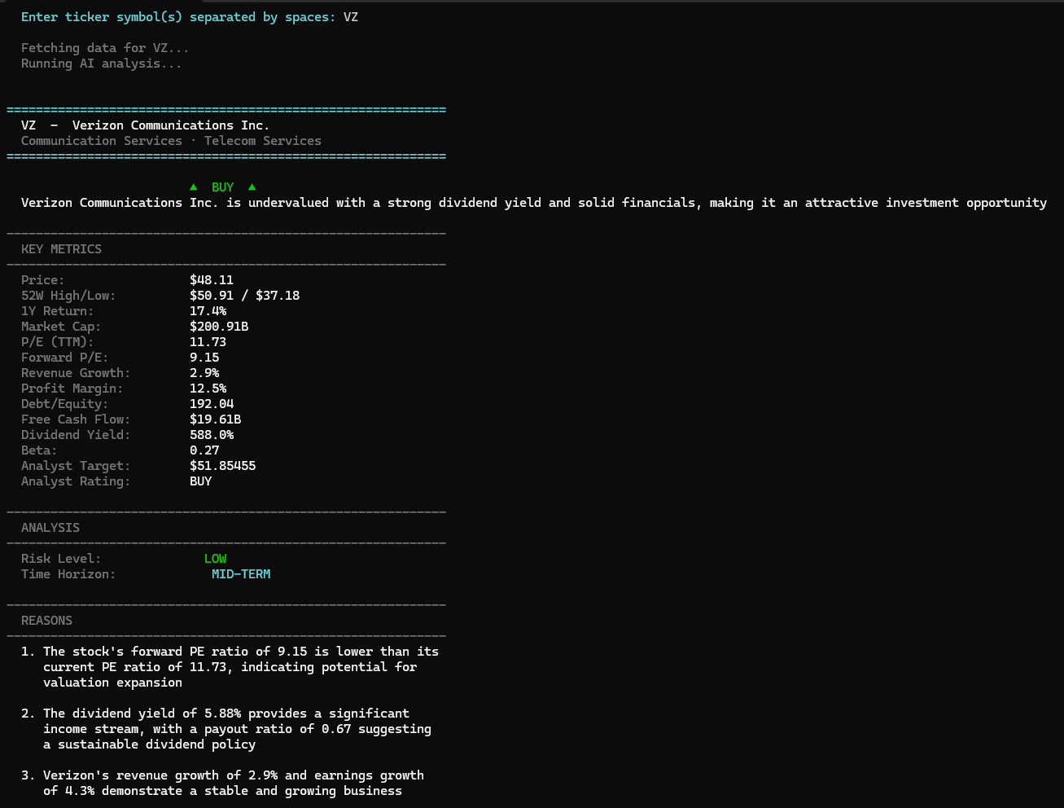
STOCK ANALYSIS TOOL BY TRAI CAJAR
SAMPLE OUTPUT ─ VZ (Verizon Communications)
AI-Powered Investment Recommendations For Those Wanting to Enter the Market (And Become Millionaires)
▲ BUY
Verizon is a solid investment due to stable financials,
REQUIREMENTS:
How to setup:
attractive valuation, and a strong 6.1% dividend yield.
Need the code from GitHub
Get a free API Key from GROQ
Go to cmd prompt and type “python -m pip install groq yfinance”
Then type in “set GROQ_API_KEY=“ (this is where your GROQ key goes)
Locate your folder within the prompt and run it with “python stock_analyzer.py”
01
Enter Ticker Symbol
PRICE
1Y RETURN
P/E RATIO
MARKET CAP
$46.38
+18.12%
11.42
$193.87B
Type any stock symbol e.g., QQQ, INTC, VZ, AMZN
FWD P/E
DIVIDEND
DEBT/EQUITY
FREE CF
8.83
6.1%
174.78
$17.24B
02
Fetch Live Market Data
AI REASONING
RISK LEVEL
TIME HORIZON
Yahoo Finance pulls price, P/E, margins, debt & more!
LOW
MID-TERM
Forward P/E of 8.83 signals undervaluation vs trailing P/E of 11.42
6.1% dividend yield provides steady income above industry average
03
AI Will Analyze Your Stock
Gross margins of 59.07% reflect strong pricing power in telecom
Groq LLM reasons over 25+ financial metrics
$17.24B free cash flow supports continued dividend payments
Analyst consensus: BUY with $51.58 target — 11% upside from current price
04
Get Your Recommendation
BUY / HOLD / SELL with 5 data-driven reasons
NOT ACTUAL FINANCIAL ADVICE

