Slide 1


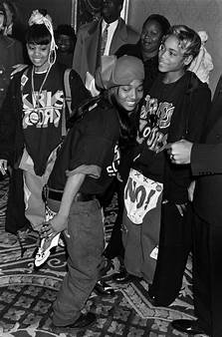




StyleMe! By: Jada Bowden
“Chorus to Closet: Find your style through your favorite hooks!”
Pick your favorite music genre, decide your all time pick artist, and voilà! Discover your new style!
OR
https://github.com/ksu-is/StyleMe-.git

