Slide 1
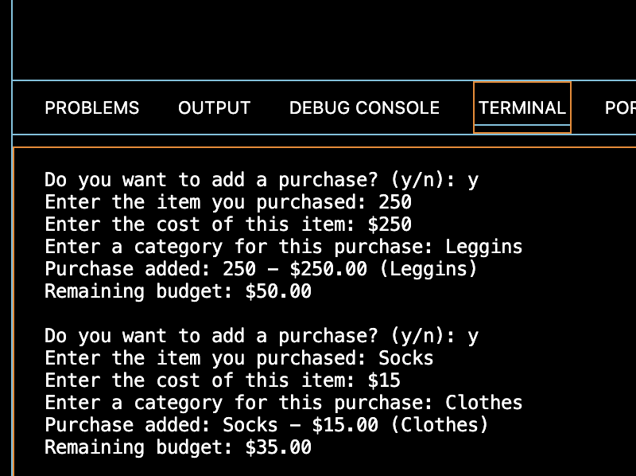

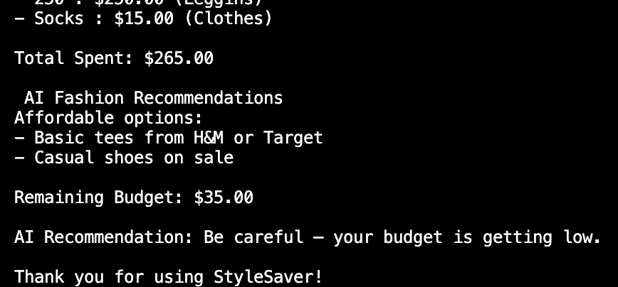
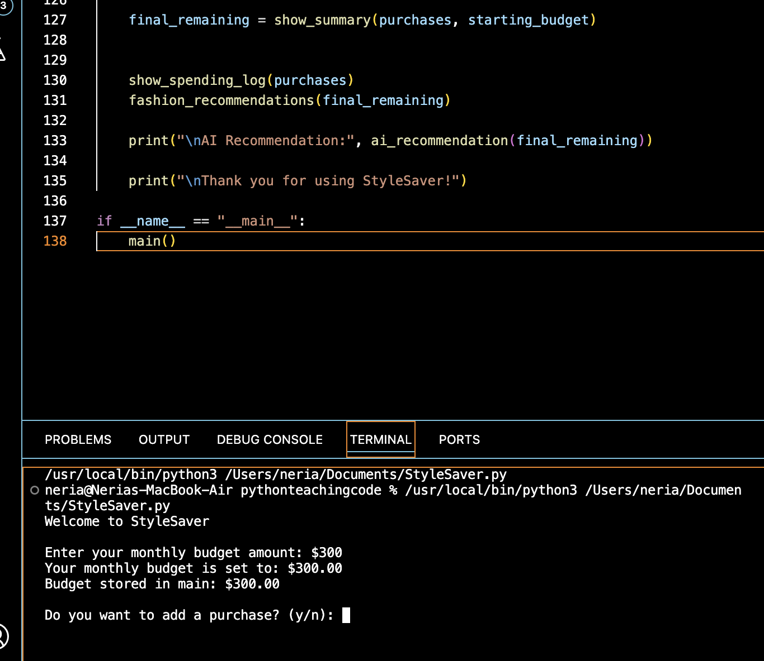
StyleSaver
Your smart assistant for staying stylish and saving money!
Tracks your spending
Personalized fashion recommendations
Budget-friendly outfits and items provided
AI recommendations and spending insights provided
Neria T. Jones

