Slide 1
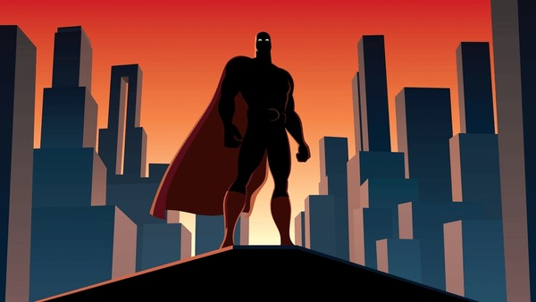
SUPER-EARTH An interactive text-based game Designed by Kendrick Hama
Defend Earth in this text-based adventure determined by your decisions!
https://github.com/ksu-is/Super-Earth-Game

