Slide 1
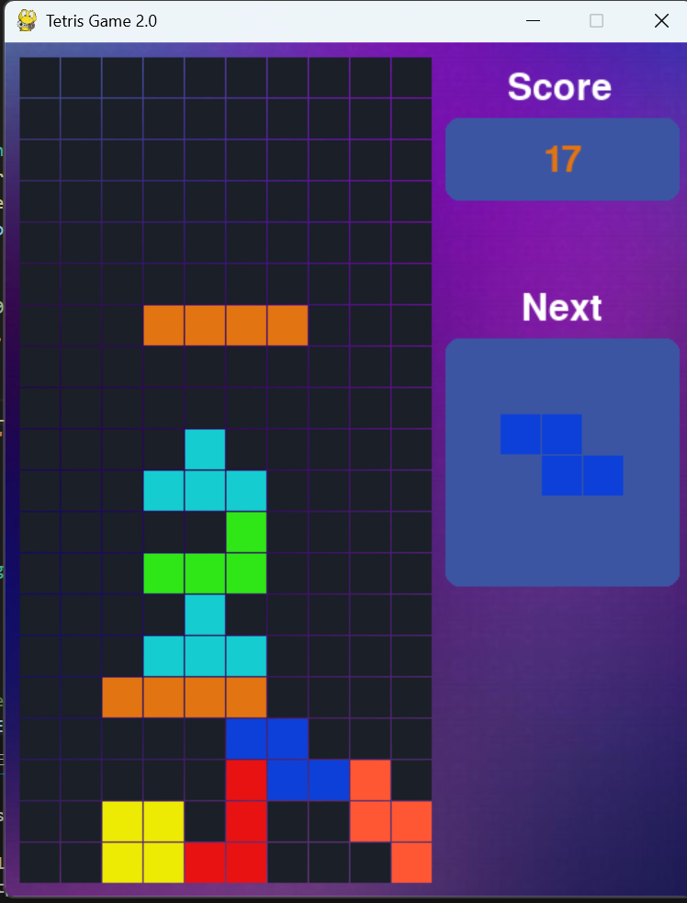
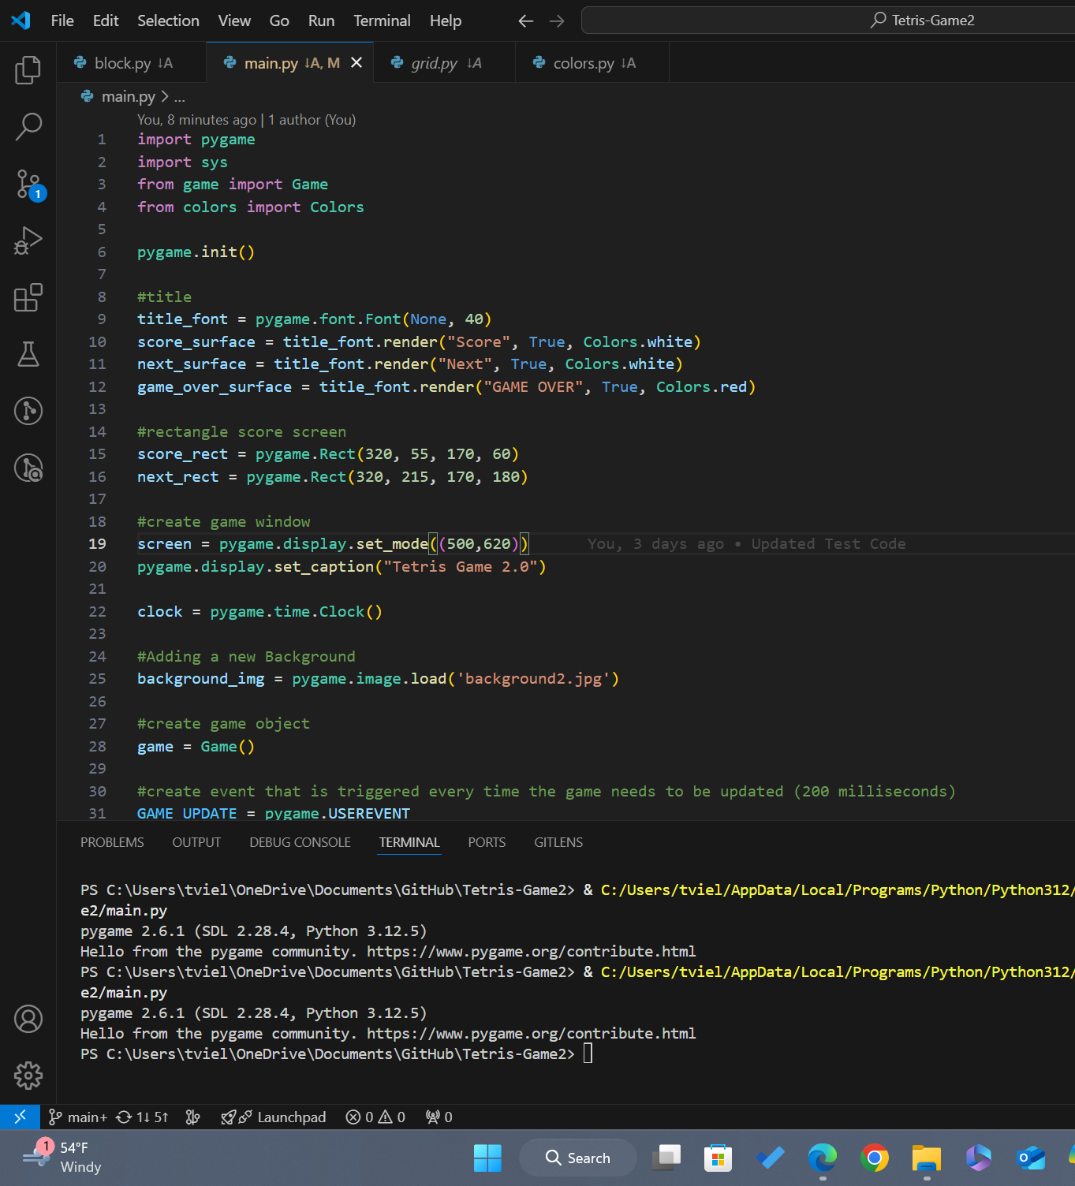
Tetris 2.0
The classic game of Tetris
Refreshed!
Workings: Developed With Pygame
What is Tetris?
A classic puzzle game where players arrange falling blocks to create complete lines and clear rows
Coder: Travis Vielot

