Slide 1
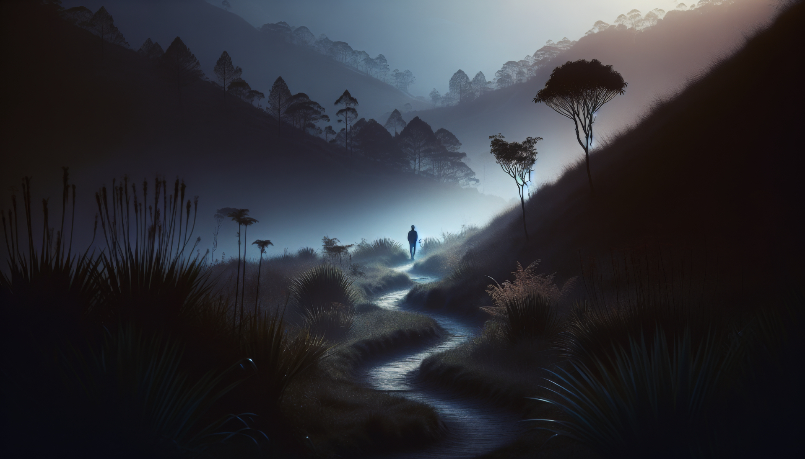
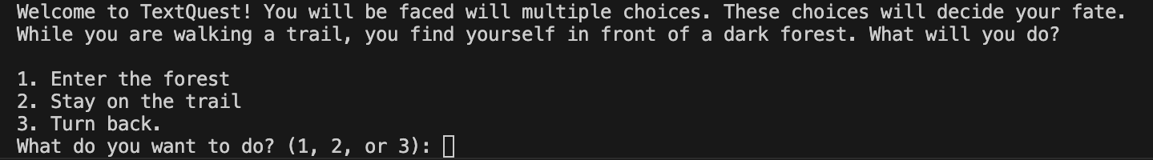
TextQuest
Can you type your way to survival?
https://github.com/ksu-is/TextQuest
Cameron McMillan

