Slide 1
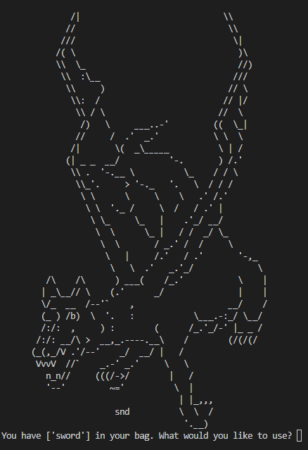
Dragon’s Lair
Text based Dungeons & Dragons Campaign
ksu-is/TheDragon-sLair (github.com)
By: Samantha Finch

