Slide 1
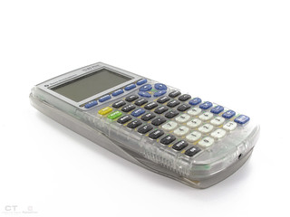
TI-Calculator
Presented by Klarelle Kanyama
This Photo by Unknown Author is licensed under CC BY

Slide 2
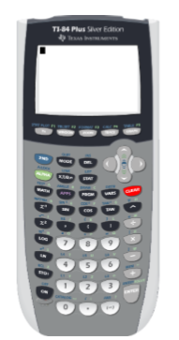
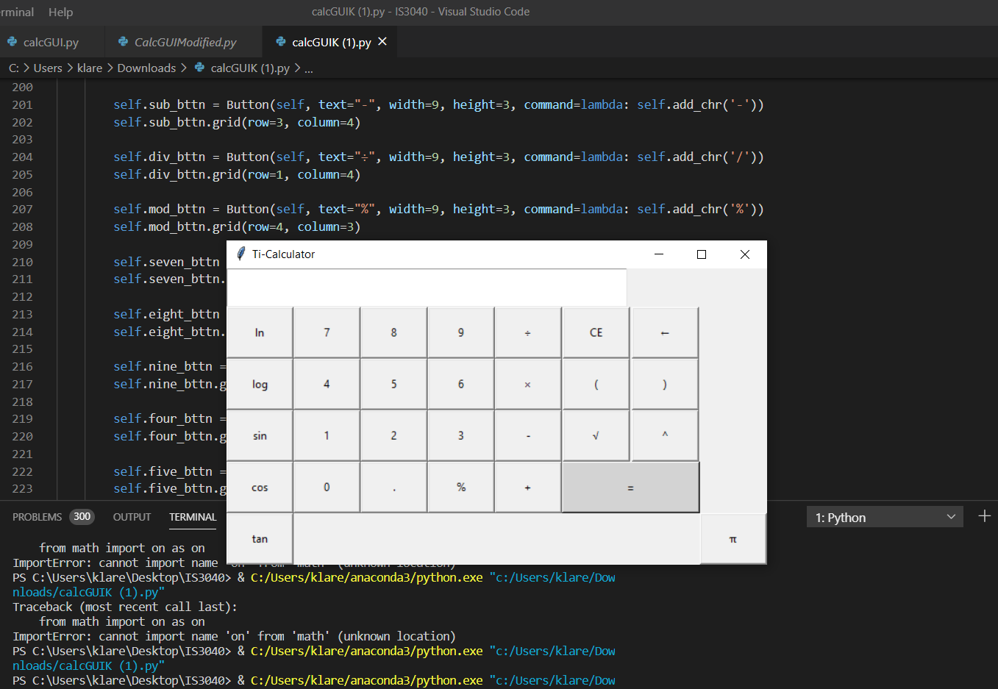
What is the project about?
The idea is to create a scientific Ti-83 with all of the digits to have a better understanding of how it works and how it’s so well programmed to have the capacity to display answers of simple to more complex questions.
This Photo by Unknown Author is licensed under CC BY-SA-NC

