Slide 1


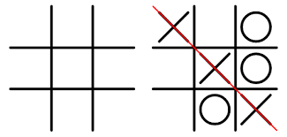
YOU VS. Computer
Tic Tac Toe Game
By: Michayla Tally
https://github.com/ksu-is/Tic-Tac-Toe-2
MiniMax Algorithm

