Slide 1
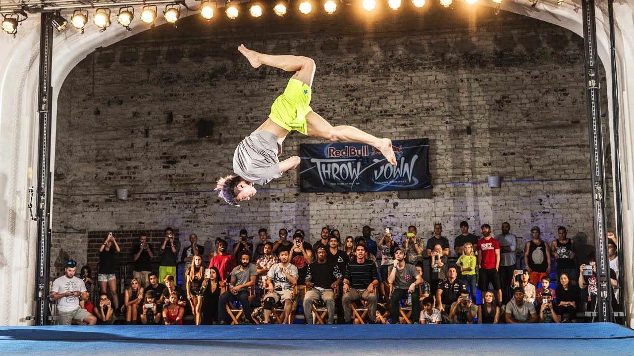
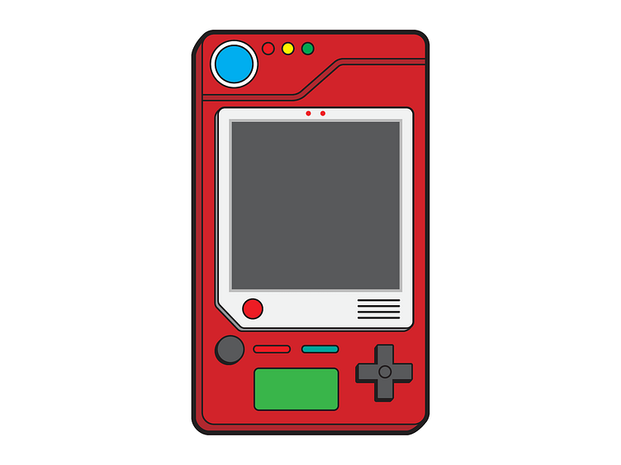
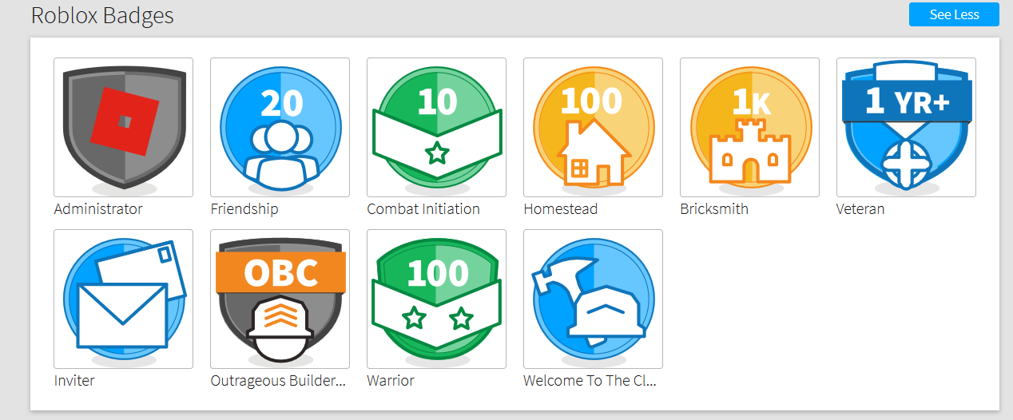


Tricking-Stat Tracker
By: Terrence Stamps
This right here is a pokedex, one of the main inspirations for this project. With one of the main features being users tracking the tricks they can land, you can say it also functions like a pokedex as well or maybe a trickerdex.
The stat tracker will take on a more fun and engaging way with the events you've gone too and instead of just tracking them like in a calendar. We're going to showcase them as badges with the gathering attended having its own unique badge for it. An idea sort of like this is Roblox's Badge System but it's based off of different achievements.
In the powerpoint background you can see a group of people watching this tricker do a skill. This is a gathering,a place where trickers come together to show their hard work and compete.
Our Tricking Stat Tracker will keep account of information most vital to trickers. When our memories fade we'll have our accomplishments in a public space for all to see, like the gatherings you went too and tricks you've landed.

