Slide 1

Ultimate Converter
Daniel Medina

Slide 2

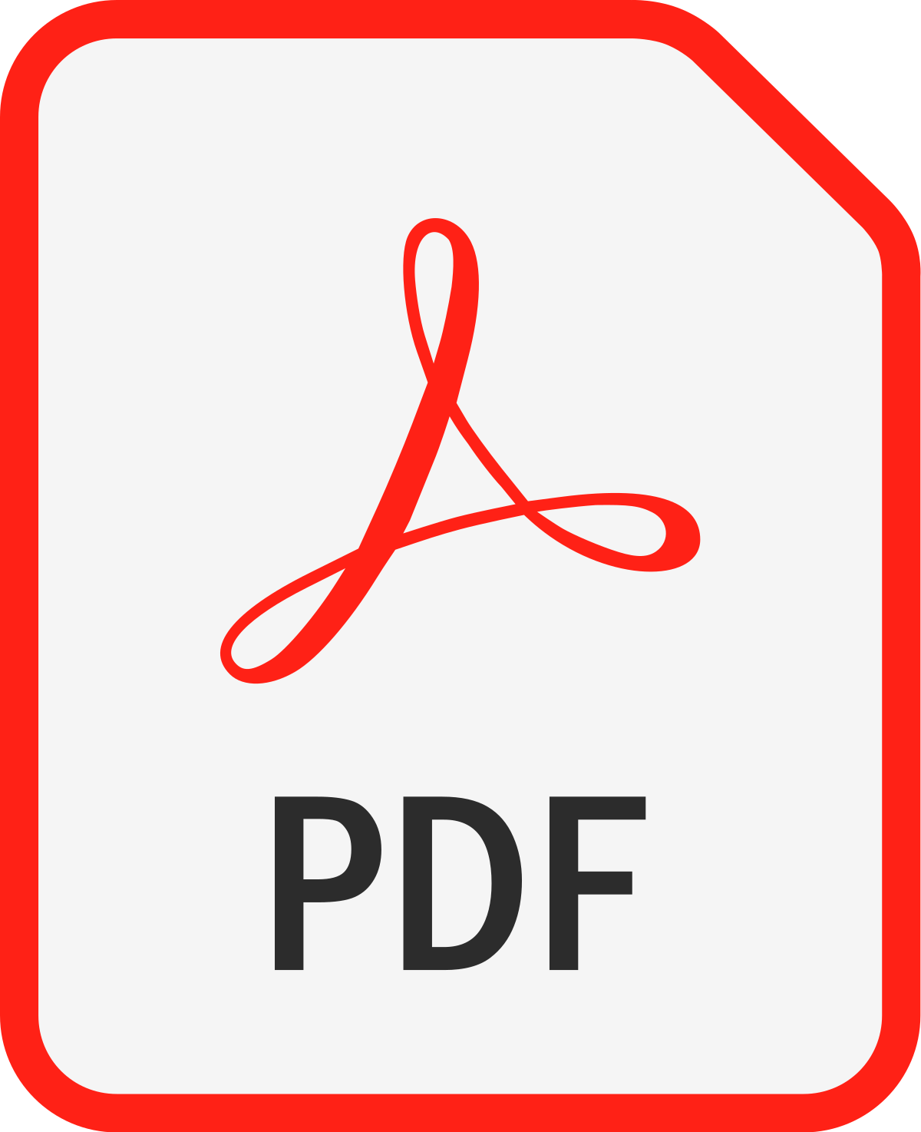

Idea
Ultimate Converter would work as an app that could help me optimize my time at work by simplifying the process of uploading documents at the CRM database with the following functionalities:
Convert Heic (iPhone) files to JPG
Convert pictures into PDF
Merge multiple pdf files

Slide 3
Sources
Let’s go to Github

Slide 4
Obstacles
Py vs Python command in cmd
Installing libraries – laptop vs Desktop
Not using code to find file path
Creating and Integrating a GUI to somebody else’s code

Slide 5
Project Development Path
Explore multiple repositories
Rejected code
Accepted code
Created a basic GUI
Call function from each code into each bottom of my GUI

Slide 6

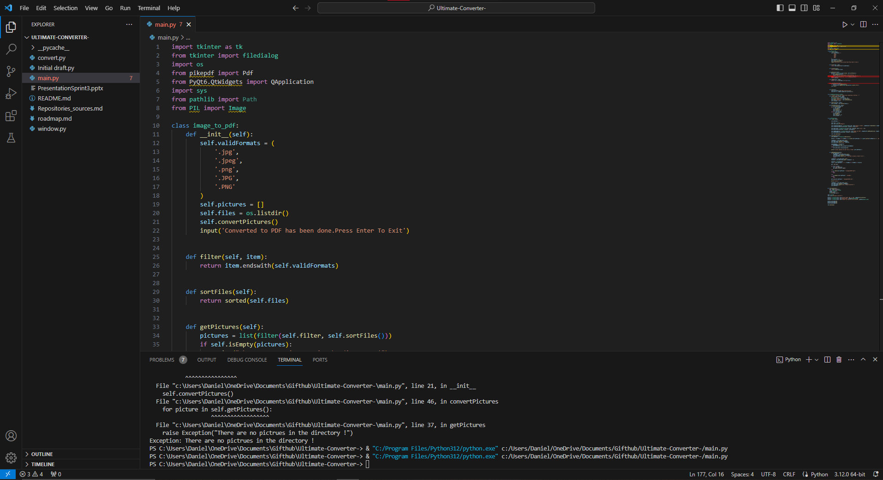
Let's see some code!

Slide 7
What would you do next?
Avoid the app closing after using file Converter
Improve general GUI for better user experience
Allow naming the OUtput
Experiment - Maybe change to Flask

