Slide 1

https://github.com/ksu-is/UniZen
Dana Safi & Jason Wilson

Slide 2

Introduction
UniZen is an innovative software application designed specifically for college students to support their mental well-being throughout their academic journey. With the pressures of coursework, exams, social life, and transitions to adulthood, many students experience stress, anxiety, and other mental health challenges. UniZen aims to be their trusted companion, providing tailored support, resources, and guidance to help students thrive academically and emotionally.

Slide 3
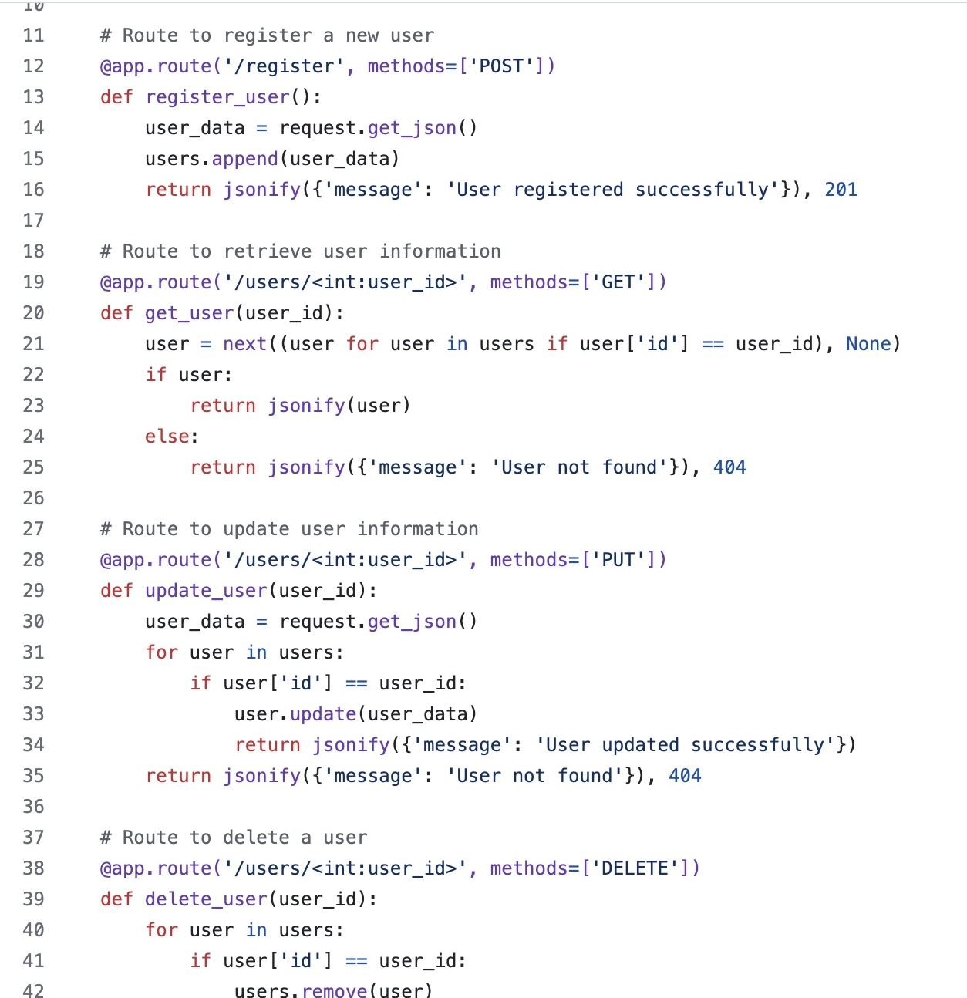
Features of the App
Offers a wide range of features designed to address the unique needs and experiences of college students.
Includes mood tracking to help students understand their emotional well-being and identify patterns over time.
Offers personalized recommendations for stress relief activities, mindfulness exercises, and self-care practices based on individual preferences and schedules.
Provides access to resources such as mental health hotlines, campus counseling services, and self-help articles on topics like time management, resilience, and coping with academic pressure.

Slide 4
UniZen: Your Mental Health Companion on Campus
Key Components of Code
Conclusion
Flask Backend: UniZen is built using Flask, a Python web framework, for flexible and efficient backend development.
Flask-Assistant Integration: Integration of Flask-Assistant enables conversational chatbot features, providing interactive support to users.
Database Integration: UniZen integrates with a database for storing user information and agenda data securely.
User Registration: Users can register via the '/register' endpoint, allowing them to personalize their UniZen experience.
Agenda Management: UniZen provides users with the ability to manage their tasks and events through dedicated endpoints for adding, viewing, updating, and deleting agenda items.
Chatbot Interaction: The chatbot component of UniZen responds to user queries, offering assistance and guidance on mental health-related topics.
In summary, UniZen offers a comprehensive solution for college students to prioritize and enhance their mental well-being. By providing personalized support, accessible resources, and an AI chatbot, UniZen empowers students to navigate the challenges of college life with resilience and success. Prioritize your well-being with UniZen and thrive in college. Start your journey today!

