Slide 1

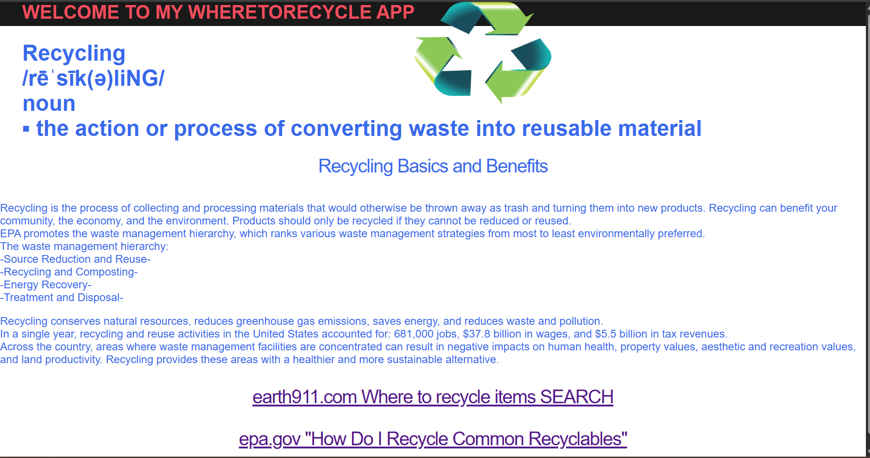
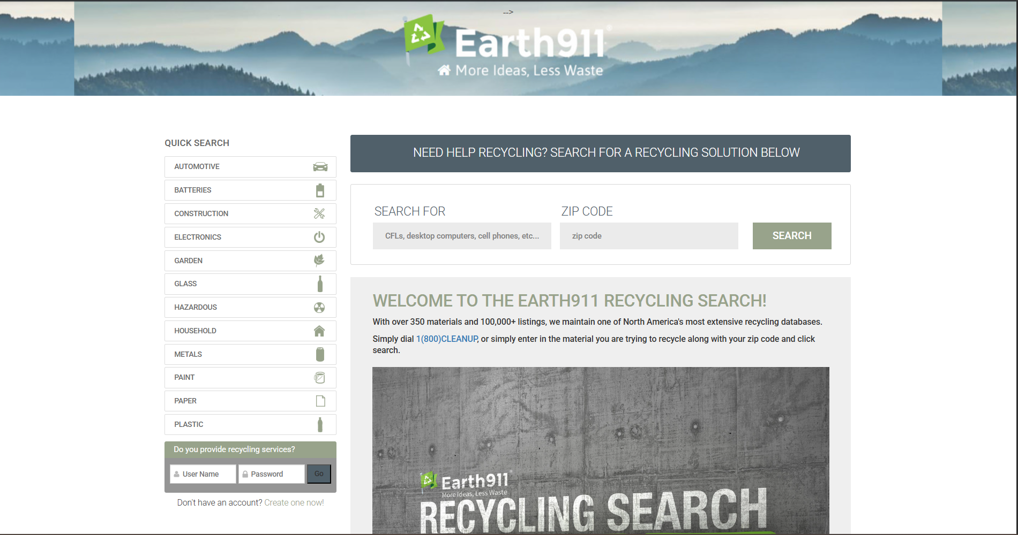
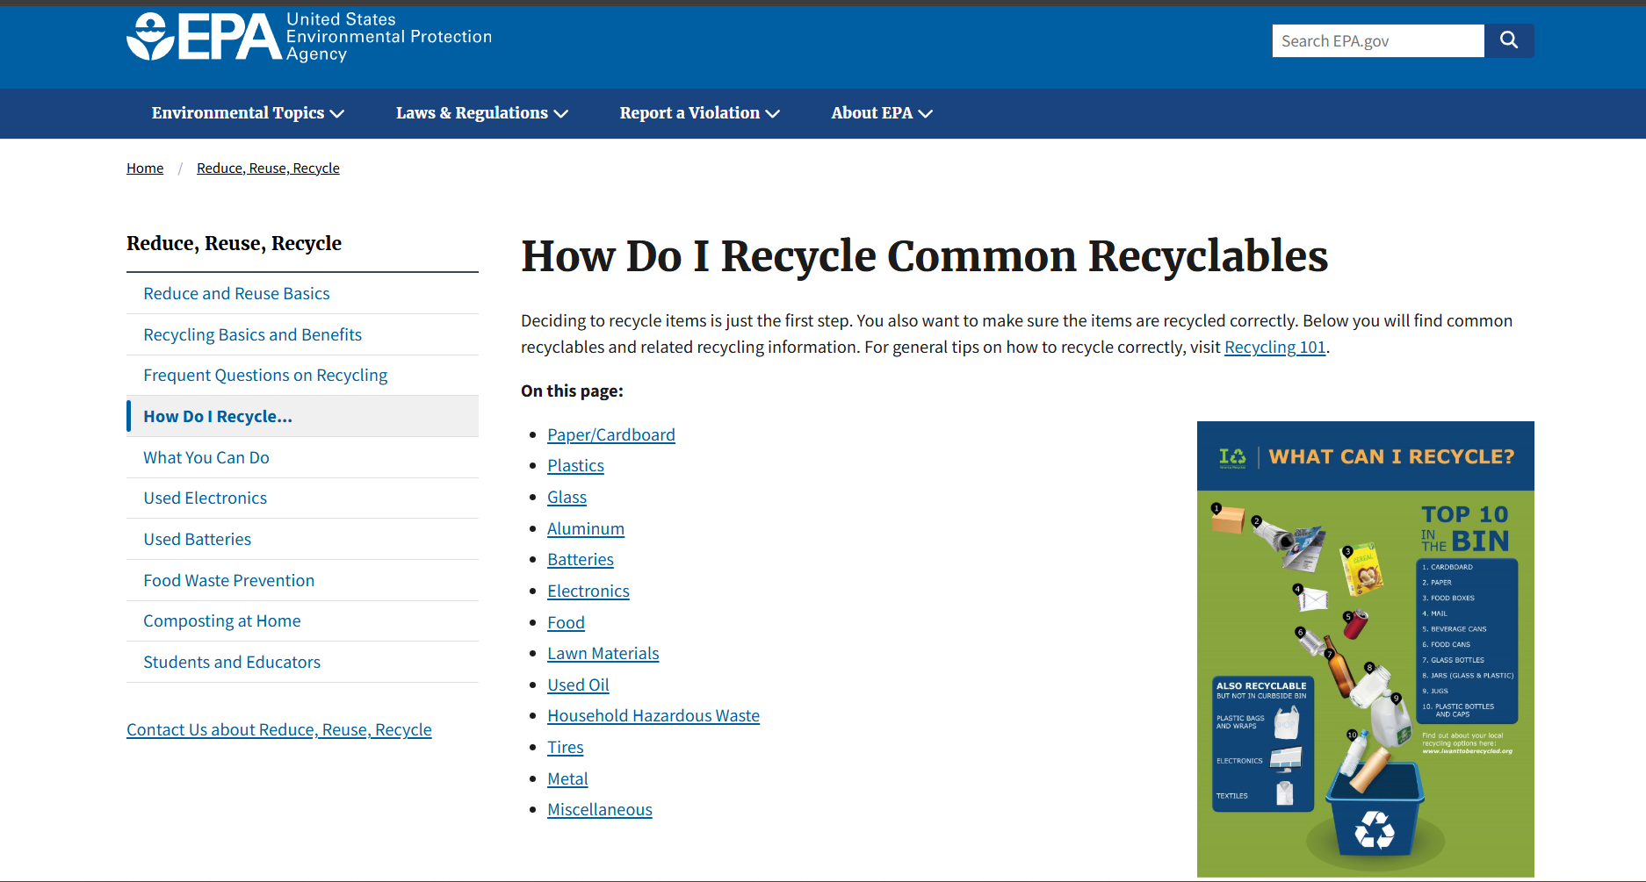
WhereToRecycle created by Bess Whitfield https://github.com/ksu-is/WhereToRecycle-BW
The WhereToRecycle app is a webpage that provides the user with information about recycling and links to websites where the user can click to find information on how to recycle certain items, as well as search where to recycle an item by entering the name of an item and a zip code.

