Slide 1

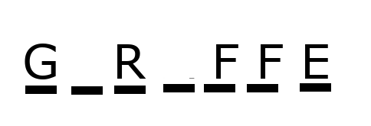
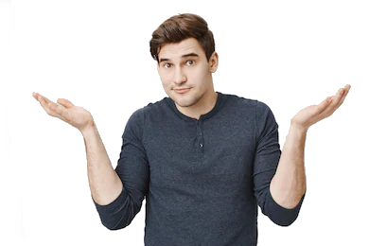
Word Guessing Game
How many can you get right?
Coders: Daniel Audinet
Code: https://github.com/ksu-is/Word-Guessing-Game.git

