Slide 1
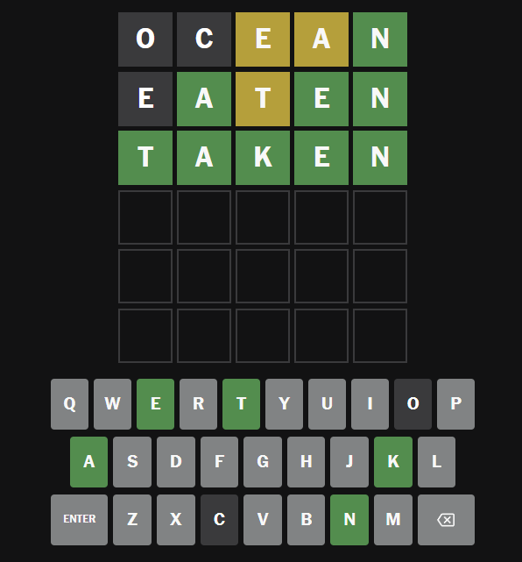
Word Guesser
How to play:
Guess a random 5-letter word
A letter will be green if it’s in the correct spot
It will be yellow if it’s in the word, but not in the correct spot
It will be gray if the letter is not in the word
You have 6 chances to guess the correct word
David Kirkley
https://github.com/ksu-is/WordGuesserGame

