Slide 1
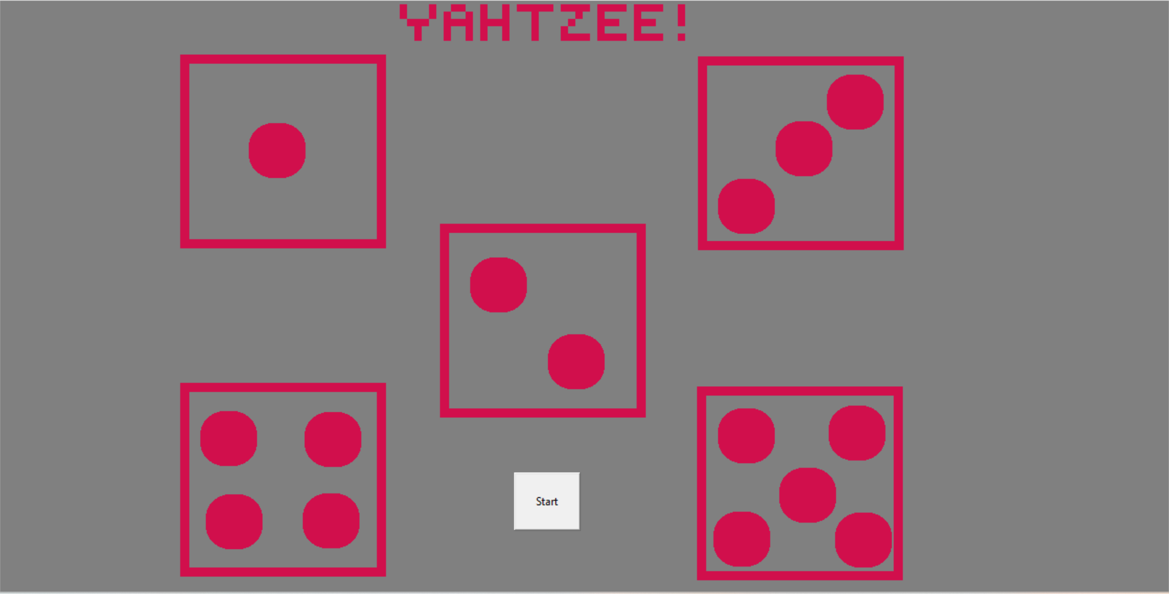
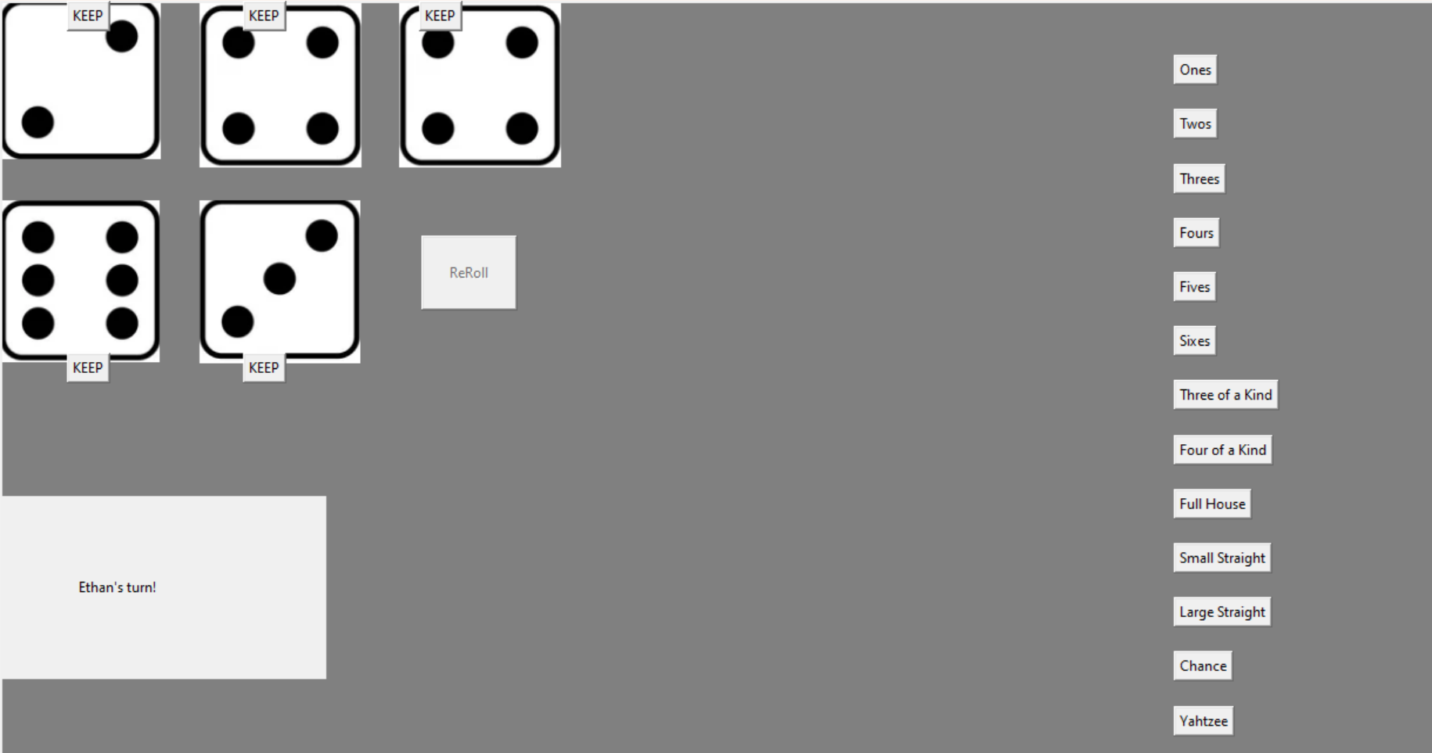
Yahtzee! (Tkinter)
By: Ethan Wickman
Classic Yahtzee, right at the user’s fingertips.

