Slide 1
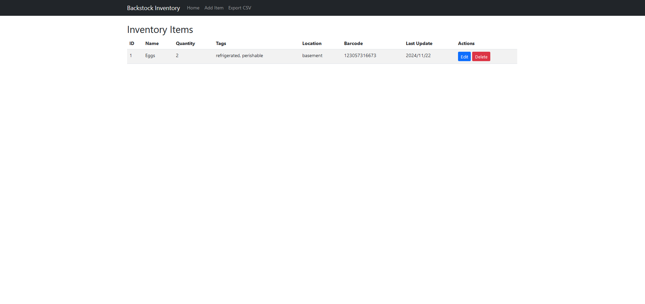
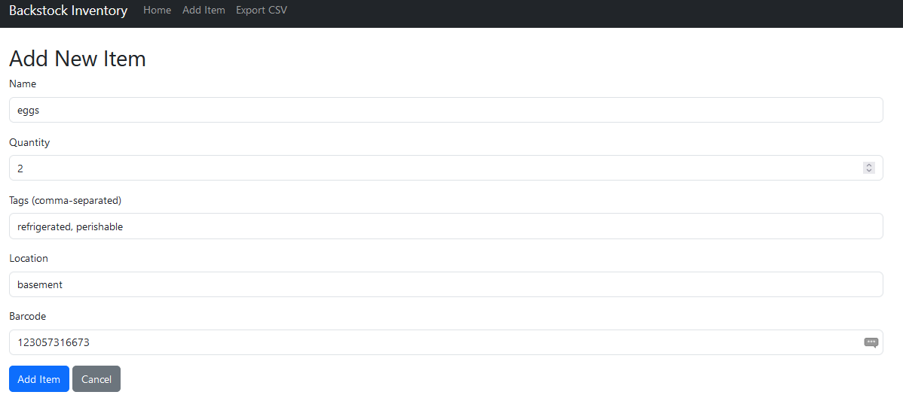
Backstock Inventory Manager
By: Gregory Bunn
This project is aimed to simplify the ownership of a backstock. It will track the names, quantity, tags, location, and the barcode number of items added, with each item editable.

