Slide 1
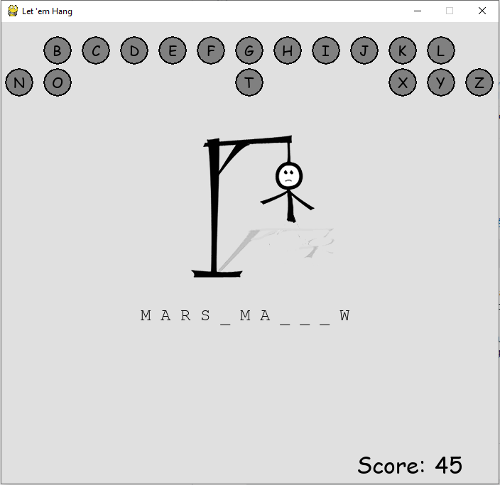
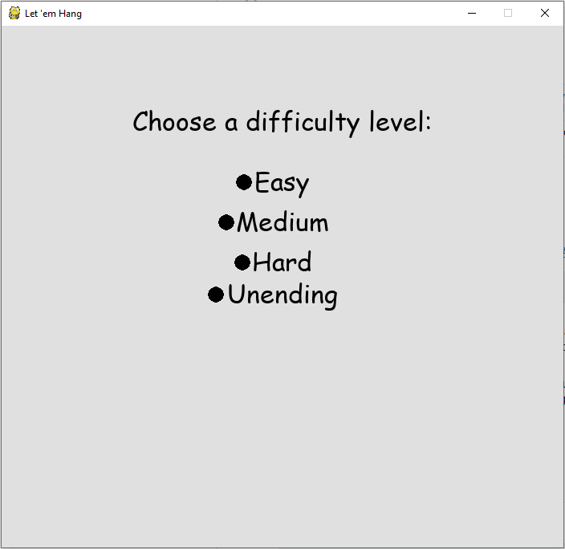
Let ‘em hang
Developer: Casey Hoskins
Hang man with advanced competitive features.

