Slide 1
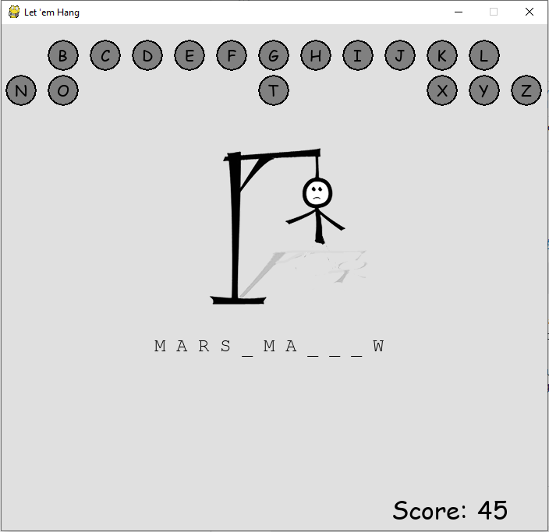
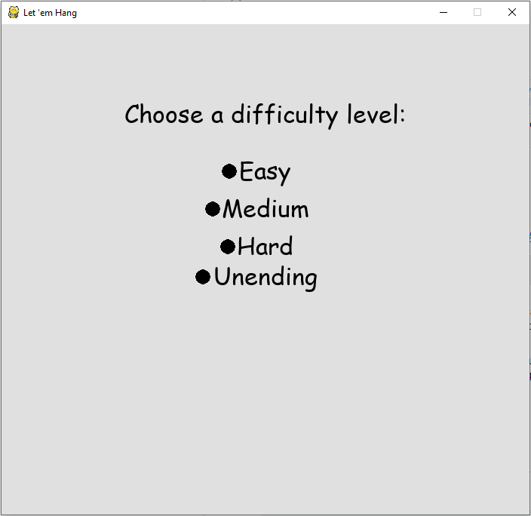
Let ‘em hang
Developer: Casey Hoskins
Hang man with advanced competitive features.
https://github.com/ksu-is/casey-hoskins-hangman

