Slide 1
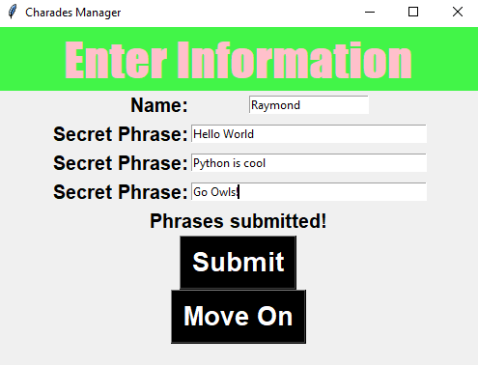
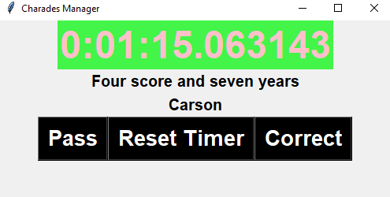
CHARADES MANAGER
Play a hilarious, fast-paced word-guessing game with your friends!
?
Enter fun phrases…
… and get your teammate to guess them before time runs out!
?
?
?
?
Additional Contributions: Timer Widget: Ostcrom Game Rules: Carson Claud Playtesting: Goslow Family
Developer: Raymond Goslow

Slide 2
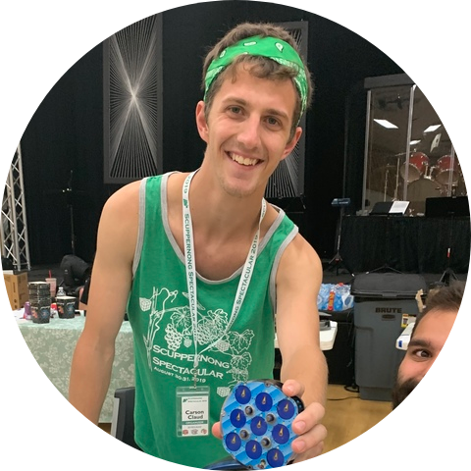
My Project Idea
I wanted to turn a pen-and paper game that my friend Carson taught me into a computer game
1
Rules in a nutshell: write down phrases, select them randomly, get your teammate to guess the phrase before time runs out
What I needed: ability to enter phrases, present them randomly, display a timer, keep track of team scores

Slide 3
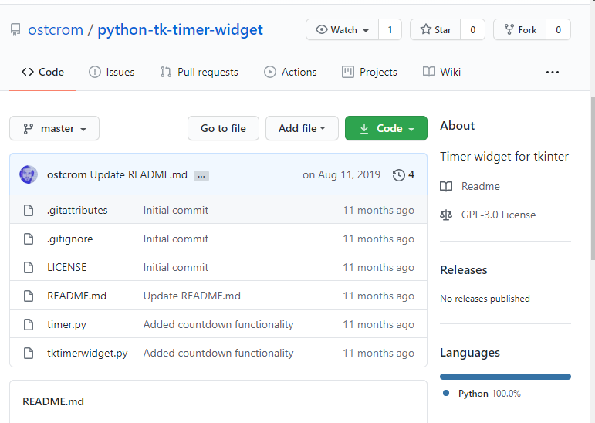
Source Code
I decided to use tkinter for the GUI
Searched GitHub for timer widgets in tkinter, found one that fit perfectly
2
Modified source code to fit my needs (fixed bugs, removed extra buttons, modified appearance)
All other code in the project was my own work, though I did use various resources to learn certain things

Slide 4
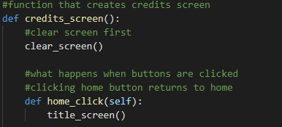
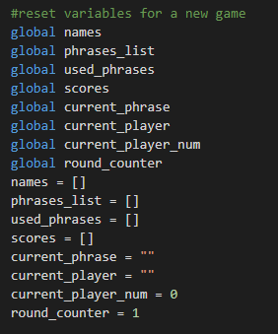
Project Development
Created functions for each “screen” in the game (home, gameplay, results, etc.)
Scope generally narrowed due to time constraints and difficulty of working with timer source code
3
Some things were easier than I expected (exporting phrases as txt file) and others were harder (getting variables to reset at end of game)
Now let’s look at the code!

Slide 5
Next Steps/Lessons Learned
What I would do next:
What I’ve learned
Incorporate timer functionality into game logic (not just as a display)
How to make a program with multiple graphic screens using tkinter
4
Bring back phrases_dictionary to allow restrictions on who sees certain phrases
How to incorporate source code from other developers into my own program
CHALLENGE: use a server to make the game multiplayer online
How to use GitHub and code comments to document my work and make it usable for others

Slide 6
THANKS FOR WATCHING!
END

