Slide 1
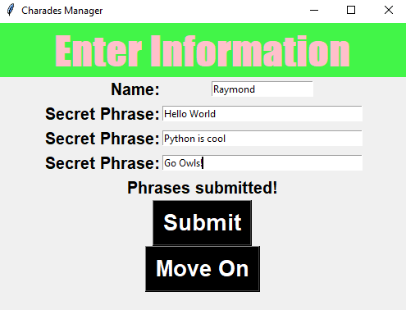
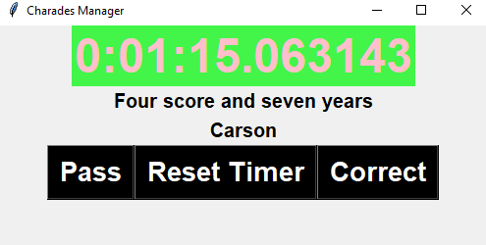
CHARADES MANAGER
Play a hilarious, fast-paced word-guessing game with your friends!
?
Enter fun phrases…
… and get your teammate to guess them before time runs out!
?
?
?
?
Additional Contributions: Timer Widget: Ostcrom Game Rules: Carson Claud Playtesting: Goslow Family
Developer: Raymond Goslow

