Slide 1
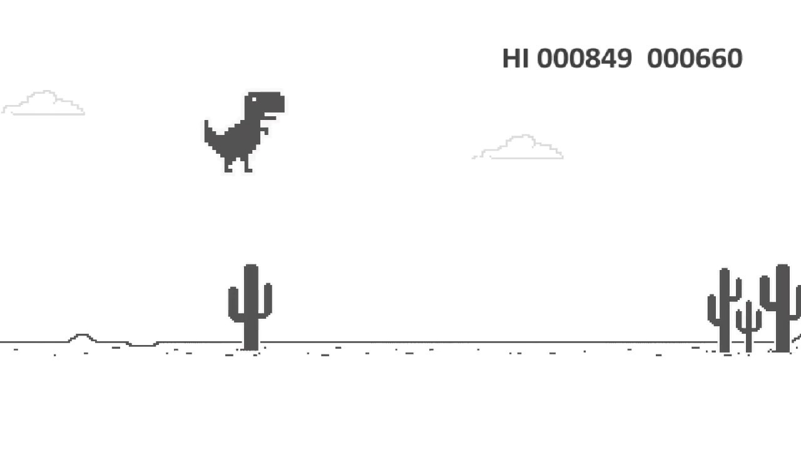
Dino Dash
Recreating the classic chrome dino run game
Caleb Riley

