Slide 1
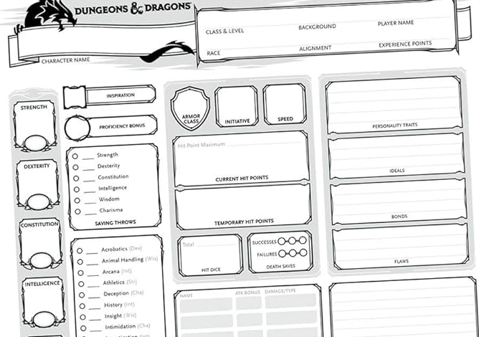
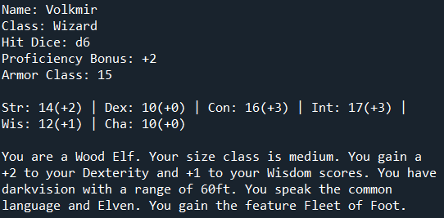
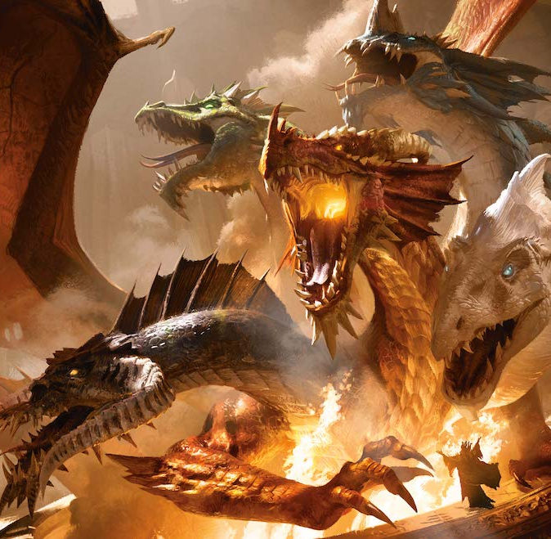
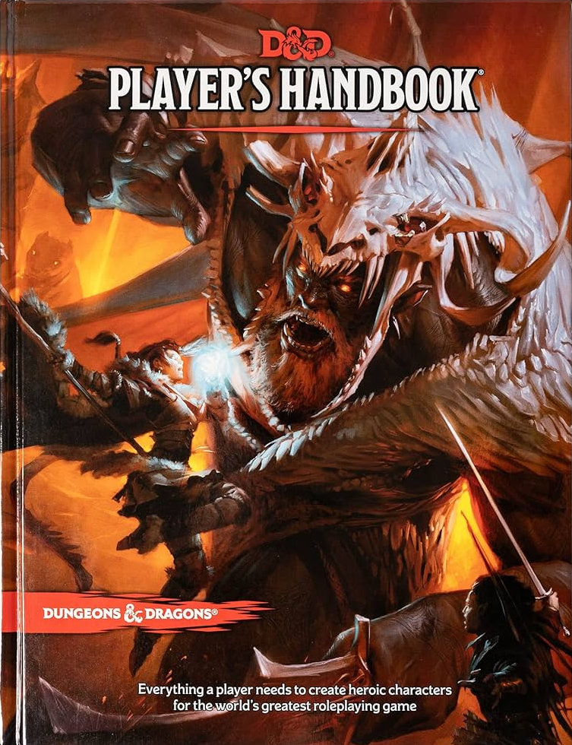
Dungeons and Dragons: Character Sheet Generator
Create game ready Dungeons and Dragons 5th Edition character sheets with ease. No need for books.
Code Author: Mason Nix
https://github.com/ksu-is/dnd-character-generator

