Slide 1
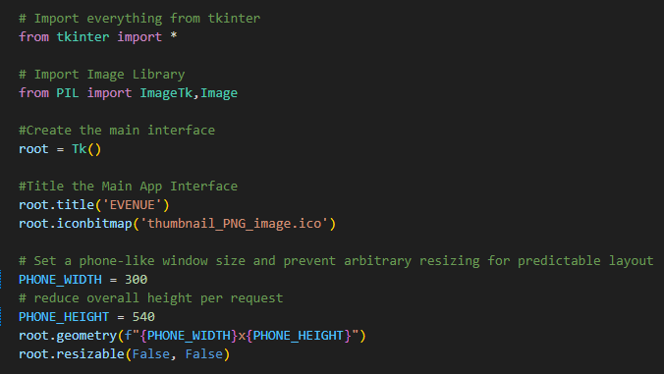
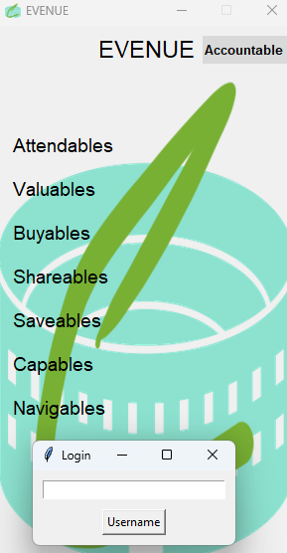
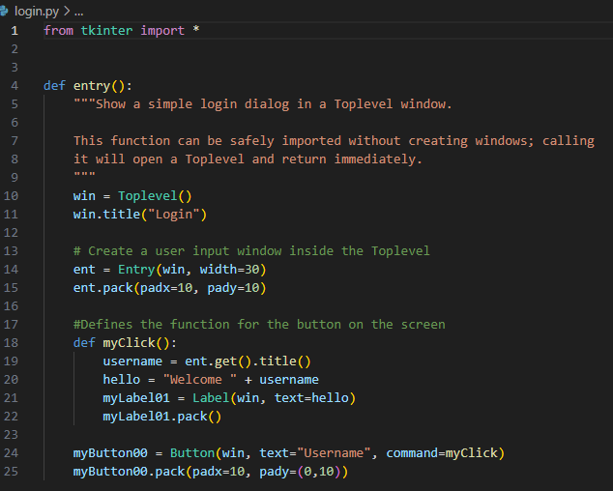
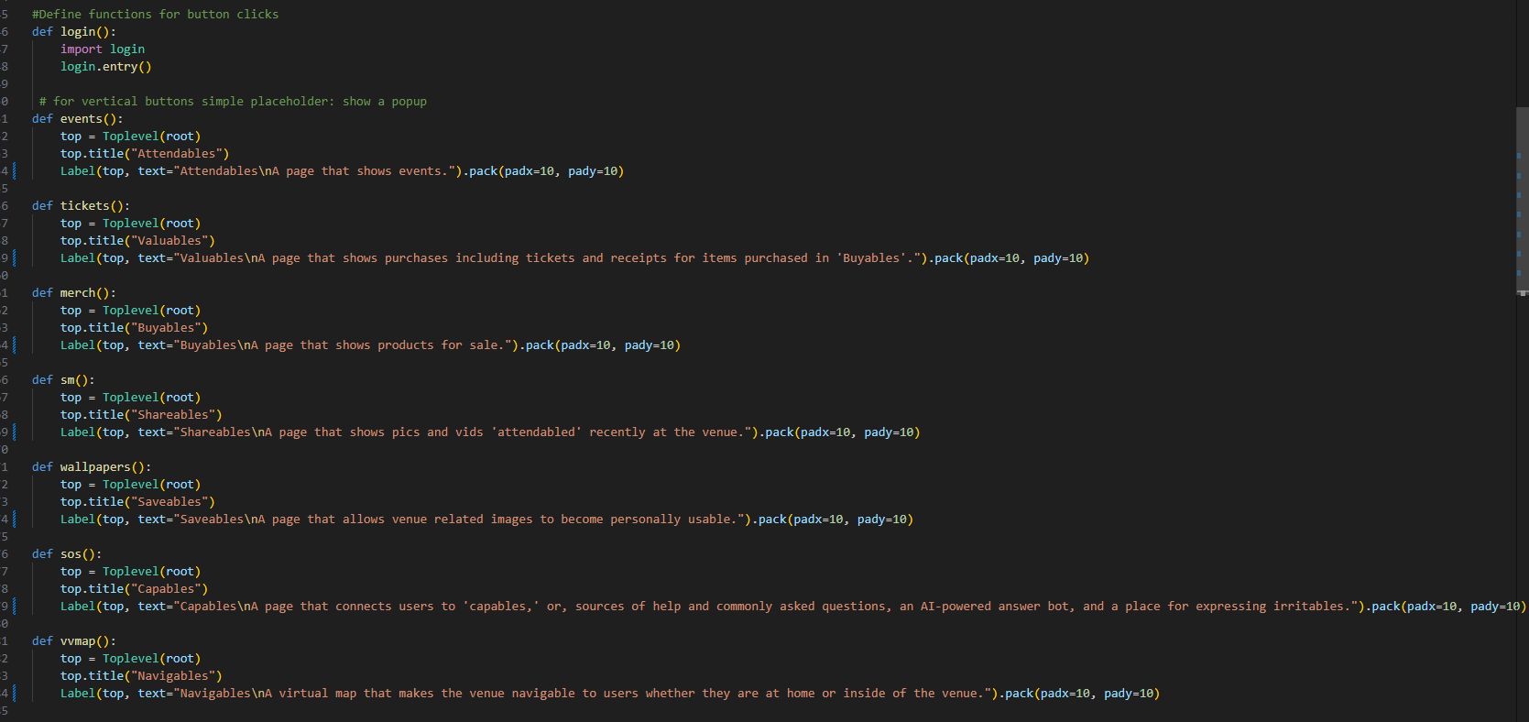
EVENUE
#A preliminary interface
set up with icon
A project by Christina Weir
https://github.com/ksu-is/evenue
Create a culture for your venue presence online.
Sell merch directly to the patrons who love your venue’s brand and...
#A preliminary login function
Notify patrons of events that may interest them.
Share content that will drive both interest, and sales.
Provide an easy interface for patrons to learn all there is you have to offer.
#A preliminary definition for a button function on the main interface

