Slide 1
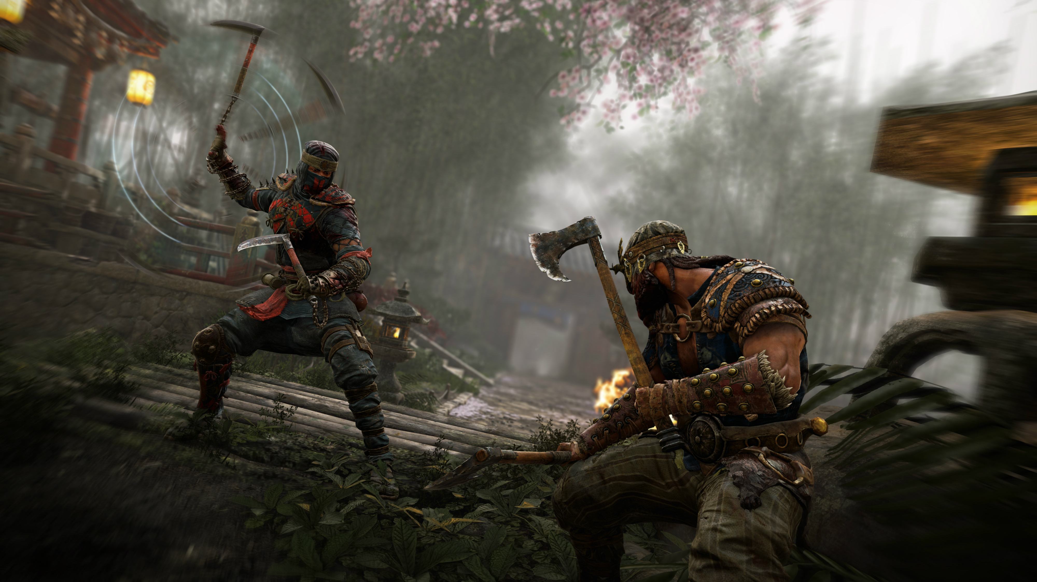
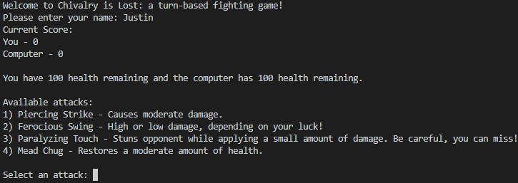
CHIVALRY IS LOST
A TURN-BASED FIGHTING GAME
By: Justin deshan
Original code: https://gist.github.com/jcyktor/018780dc65e3354c5606

