Slide 1
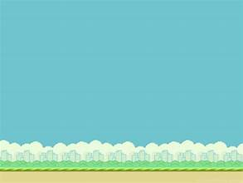
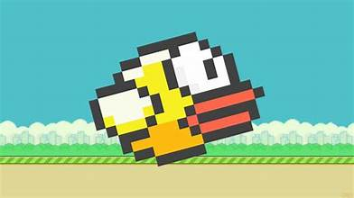
Flappy Bird by Tyler Carver
A fun remake of the game that took the world by storm in 2013. It was deleted from the Appstore shortly after its release. It’s a race to see who can earn the highest score!
https://github.com/ksu-is/flappy-bird2023/blob/main/flappybird.py

