Slide 1


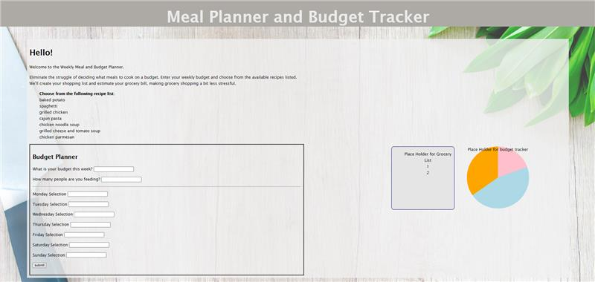
Meal & Budget Planner
Help you decide what meals to cook on a budget.
Coders: Kristy Musgrove and Allyson Hamilton
sources: https://github.com/gavindsouza/inventory-management-system

