Slide 1
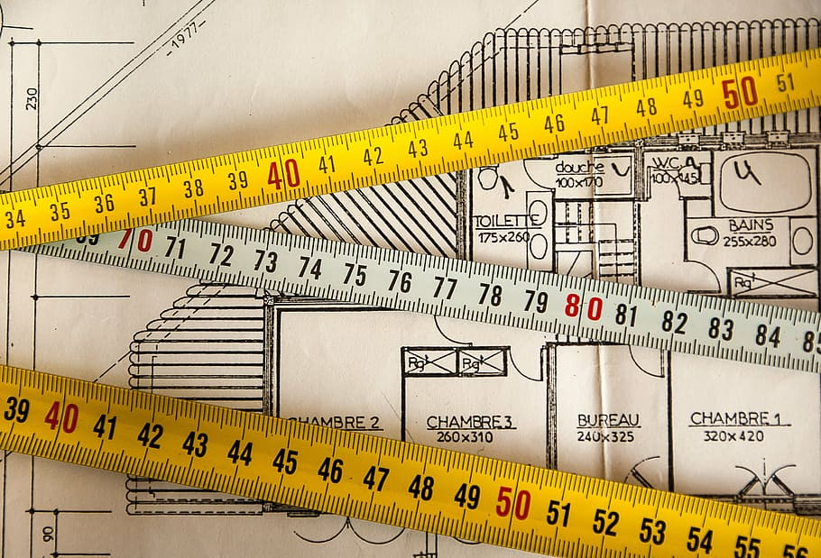
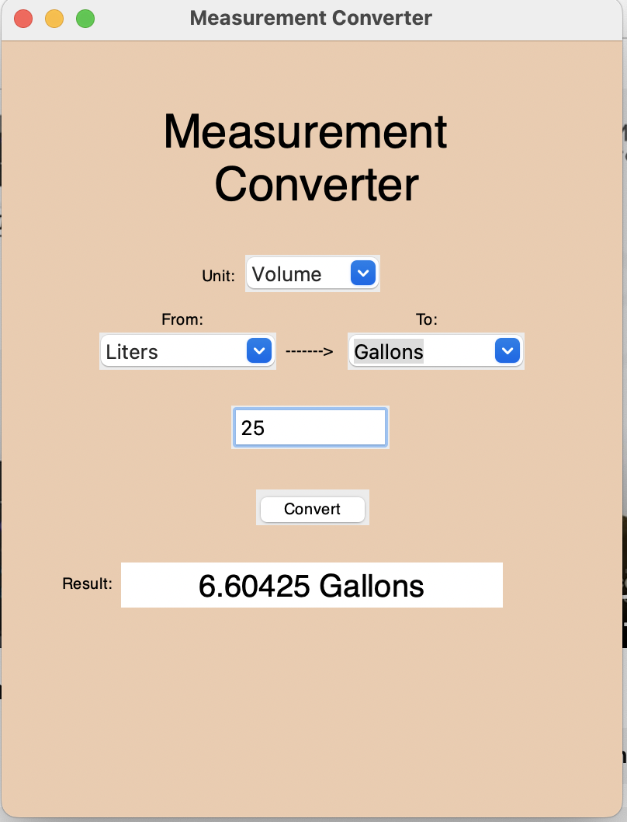
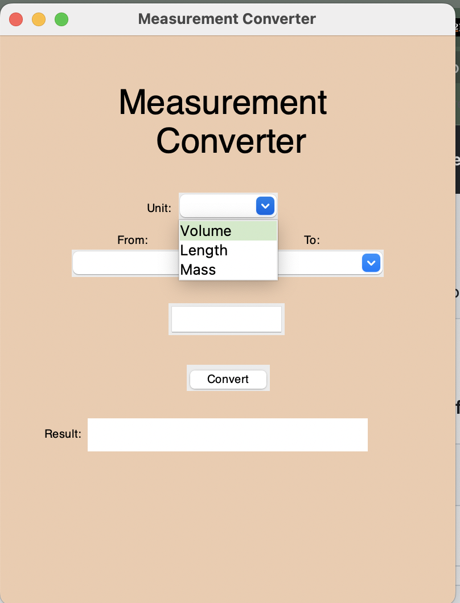
Measurement Converter
Convert with Confidence:
Streamline Your Workflows
with Our Unit
Conversion Software!
OVER 100 CONVERSION COMBOS!
Coder: Lawrence Chu

