Slide 1
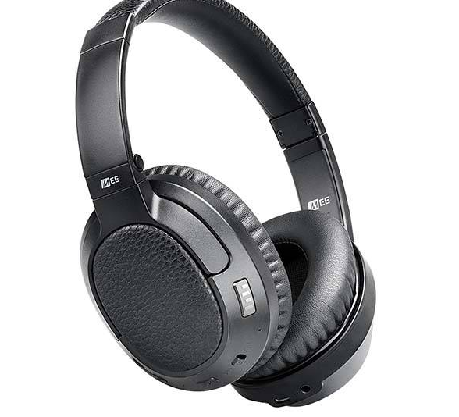
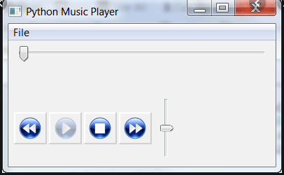
MusicPlayerGUI
Uses python with Tkinter and Pygame
A lightweight standalone music player for local music files
By: Mitchell Wells

