Slide 1
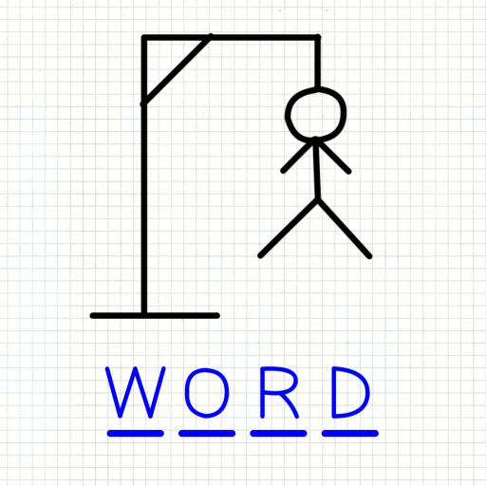
One Man Hang Man
The classic childhood game... with just one user!
By: Shelbi Pittman

