Slide 1

PitchSide Soccer Stats
By Esmail Trabulsi

Slide 2

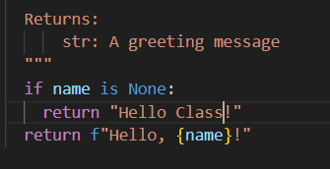
My Code
My Code involves adding updates to standings and current players and managers active and inactive due to injuries, firings, or suspensions.
One of the small things I thought I would do is let it address you guys as a class as I am presenting to y'all instead of Hello World.

Slide 3
Github
https://github.com/ksu-is/statsball

